Slide 1
2017 ACAAA Annual Conference ROMA Next Gen Update
Terry Bearden, Programs and Development Director
Arkansas Community Action Agencies Association, Inc.

Slide 2
What is ROMA Next Generation?
NASCSP: Just as ROMA has served Community Action well for over twenty years, ROMA Next Generation represents a new level that will move CSBG forward and strengthen Community Action over the next 5-10 years.

Slide 3
The Critical Connections
Community
Assessment
Strategic
Planning
Community
Action Plan
CSBG
Congressional
Report
CSBG State
Plan
CSBG Annual
Report

Slide 4
Other ROMA Next Gen Workshops
Integrating ROMA Next Gen: Strategies That Will Work
10:45 a.m. – 12:00 p.m. Belle Starr Room
Focus: Community Action Plan

Slide 5
Other ROMA Next Gen Workshops
Strategic Planning: A Focus on the ROMA Cycle
2:00 p.m. – 3:15p.m. Belle Starr Room
Focus: Strategic Planning

Slide 6
Other ROMA Next Gen Workshops
Conducting Community Assessments and Using the Results for Planning
3:45 p.m. – 5:00 p.m. Belle Starr Room
Focus: Community Assessment

Slide 7
Other ROMA Next Gen Workshops
Ensuring Financial Accountability and Compliance
3:45 p.m. – 5:00 p.m. Memphis
Focus: CSBG Annual Report

Slide 8
Putting --- all of --- the Pieces Together
Assessment
Planning
Implementation
Achievement of Results
Evaluation

Slide 9
HOW DOES ROMA NG FIT INTO ROMA?
The ROMA Next Generation framework builds on ROMA principles and practices to support agencies and states as they gather and use data at all points of the cycle. Data collected and analyzed from assessment through evaluation allow us to identify our successes and our challenges and make use of the information for continuous improvement.
What has changed for the people we served? What has changed for our community? What Outcomes were achieved and for whom?
What Services and Initiatives contributed to achieving the Outcomes? What can we improve to better respond to local needs?
What does data tell us about the needs in our specified community? What identified needs can we reasonably address either independently or in partnership with other organizations?
How will we strategically respond as an agency to individual, family, and community needs? What impact do we want to have? What are our performance targets?
What services and initiatives do we select?
Did the Outcomes achieved address the needs identified in the assessment phase? How well did we track our success? Did we meet our targets?
Assessment
Assess community needs and resources
Evaluation
Analyze data, compare with benchmarks
Planning
Use agency mission, TOC, and assessment to support services/ initiatives
How do specific Services and Initiatives (Strategies) help support and produce Outcomes to respond to the needs of our community?
How do the Core Principles in the Theory of Change help guide our agency strategic plan and community action plan?
Achievement of Results
Observe and report outcomes and progress
Implementation Implement services and initiatives (strategies) to produce results
What Outcomes are observed and measured as Community and Family level NPIs?
How do the Outcomes we are tracking move
us towards our agency goals in our local TOC?
How will we implement our unique combination of Services and Initiatives? And for what Outcomes (NPIs)?
Do we have a process for observing progress and using data to make changes as needed? Do we need to make changes to our services and initiatives?

Slide 10
Focuses of ROMA Next Gen
TOC
Data
Results
National Theory of Change
Local Theory of Change
Analysis
Use of Data
Individual / Family
Community Level Results

Slide 11
A national network of over 1,000 high-performing Community Action Agencies, State Associations, State offices, and Federal partners supported by the Community Services Block Grant (CSBG) to mobilize communities to fight poverty.

Slide 12
Let’s Break It Down: Analyzing the National Theory of Change
Community Action Goals
Create at least one Outcome Statements that would document achievement of each of the National Goals. Hint: Outcome statements describe *change* - not receipt of services, participation in programs, or processes, such as completing an application.
Services & Strategies
List a few agency programs and services that fall under each domain.
Community Action Core Principles
Identify which groups are involved in the application of core principals within a CAA – Board of directors; executive leadership team; and/or program managers & frontline staff.
Performance Management
Identify where data and information can be found to demonstrate a CAA’s performance levels in each area and how agencies might use that data and information.

Slide 13
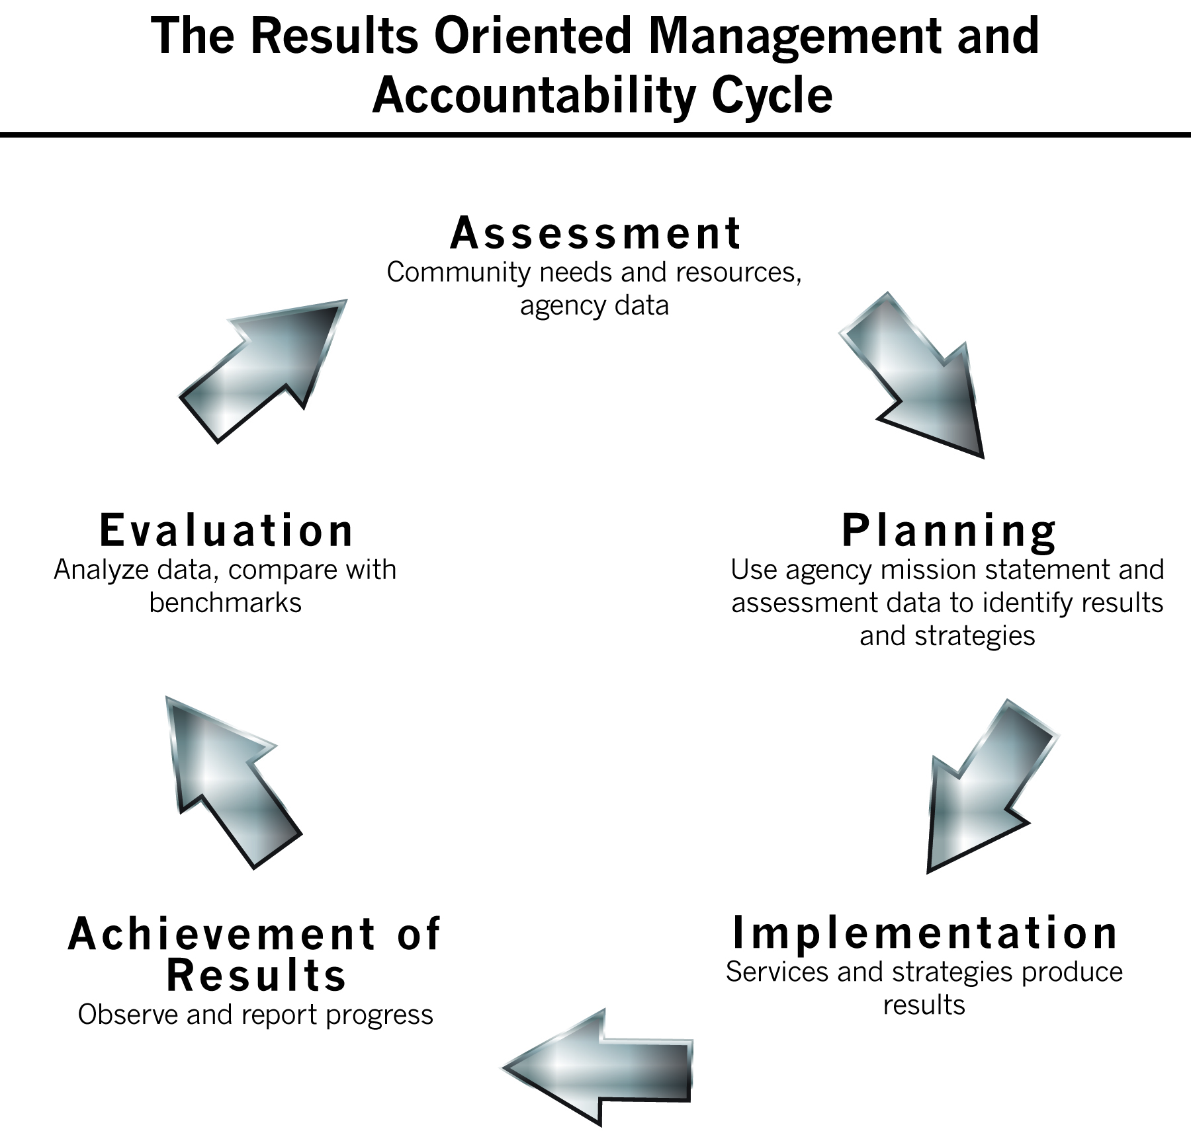
The local TOC acts as a bridge between the assessment data and the agency strategic plan.
It provides a frame for analysis of the data and helps to focus on specific data elements that will help in the development of the plan. Using the TOC, each agency will be able to talk about the relationship between the services they provide and both “program outcomes” and “overall agency outcomes” they expect to achieve.
Notes:
Some things we have been focused on in the cycle steps.

Slide 14
The TOC allows agencies to assess implementation effectiveness in a more comprehensive way.
Implementation will include understanding about how the anti-poverty role that is specifically appropriate to their agency is carried out in their services and strategies.
Notes:
Some things we have been focused on in the cycle steps.

Slide 15
The TOC helps identify the indicators that will be observed and measured. It articulates how the indicators actually demonstrate progress toward the established outcomes – and to one or more of the National Goals.
Notes:
Some things we have been focused on in the cycle steps.

Slide 16
Once services are completed and outcomes observed, the TOC will help guide the evaluation.
Did the services do what was expected?
Did the outcomes achieved validate the assumptions behind the selection of the strategies?
This analysis will then lead into the re-assessment and next planning process.
Notes:
Some things we have been focused on in the cycle steps.

Slide 17
Focuses of ROMA Next Gen
TOC
Data
Results
National Theory of Change
Local Theory of Change
Analysis
Use of Data
Individual / Family
Community Level Results

Slide 18
Data, Information and Knowledge
Data is the facts that are observed, measured, collected and aggregated.
Data only becomes information for decision making once it has been analyzed in some fashion.
Knowledge is derived from the interaction of information and experience with a topic.
Notes:
Remind participants of the example from the video, the height of Mount Everest is one piece of available data.
The height can be recorded precisely with an altimeter and entered into a database.
This data may be included in a book along with other data on Mount Everest in such a way that it provides information about the mountain that would be useful for those who wish to make a decision about the best method to climb it.
Using this information, coupled with experience with climbing mountains in general, persons seeking to reach Mount Everest's peak may be seen as having "knowledge“ about the subject.
Ask if any participant thought of an example from their own agency?
Data – For example: Demographic data about participants.
Information – For example: Is there a pattern or trend, e.g. single parent?, between ages of 20 and 35?, family with young children?, from a particular area of town?
Knowledge – For example: Considered with experience at operating a Head Start program, we recognized that there had been a shift in population and we are now serving families who have older head of household, fewer children, and a larger percent with a high school diploma.

Slide 19
Four Data Quality Attributes
Complete
Timely
Reliable
Accurate
Notes:
NOTE: a brief discussion about data collection is important (reviewing from the video), but remind that there will be a separate workshop about data collection.
Read the items in this way: Move from complete to timely to reliable to accurate.
First thing is to check for missing data. Next is it being done timely and on a regular basis. Reliability includes the understanding that the data collection process is being uniformly applied to the entire population being served? Is it consistently collected as a regular part of the work done? Is the data trustworthy? Does it make sense?
And finally accuracy is about making sure there are no typos and the data is all correct – examaple: if the customer is marked as “homeless” is s/he really homeless?
Just be sure to stress that the quality of the data is the foundation upon which all analysis will be built. Faulty or flawed data (missing elements, incorrect, not current, etc.) will produce mis-information and may cause errors in decision making.
Throughout this workshop we will be asking the “quality of data” questions and making a list of things we want to pursue to improve the quality of the agency's data collection and storage processes.

Slide 20
In Analysis of Data You Must Know What You Want to Know
Establish what you want to know
Is this driven by internal or external reporting requirements?
Is this driven by Local Theory of Change validation?
Identify who has the data and where the data is located, necessary to tell you what you want to know.
Agency programs? Input from customers?
Community statistics? Input from the general public?
Consider what “buckets” or different data classifications we need to examine.

Slide 21
Data Analysis Techniques – 1.0
Comparative analysis
Compares data over time
Compares local data to regional or national data
Compares planned outcomes to actual outcomes
Examines differences among groups
Possibly internal (different targeted populations)
Possibly external (vs. other service providers)
Notes:
These traditional analysis and program evaluation practices can be much more complicated than are presented in this workshop – when done by statisticians and professional evaluators.
We will try out the techniques using some simplified activities that an agency can do to produce important information that could help them improve their success.

Slide 22
Data Analysis Techniques – 1.0
Trend Analysis
Collecting information and attempting to spot a pattern, or trend, in the information
Although trend analysis is often used to predict or forecast future events, it is also used to explain and understand events in the past.
Trend analysis provides evidence to inform decision-making.
Trend analysis together with annual or point-in-time data provides both a short- and long-term perspective.
Notes:
These traditional analysis and program evaluation practices can be much more complicated than are presented in this workshop – when done by statisticians and professional evaluators.
We will try out the techniques using some simplified activities that an agency can do to produce important information that could help them improve their success.

Slide 23
Data Analysis Techniques
Mapping
Identifying the path and flow of information
A map:
is a graphical representation.
is a documented procedure, process, or system.
depicts relationships among its different components.
can show the flow of information, materials,
money, personnel, etc.
Notes:
These traditional analysis and program evaluation practices can be much more complicated than are presented in this workshop – when done by statisticians and professional evaluators.
We will try out the techniques using some simplified activities that an agency can do to produce important information that could help them improve their success.

Slide 24
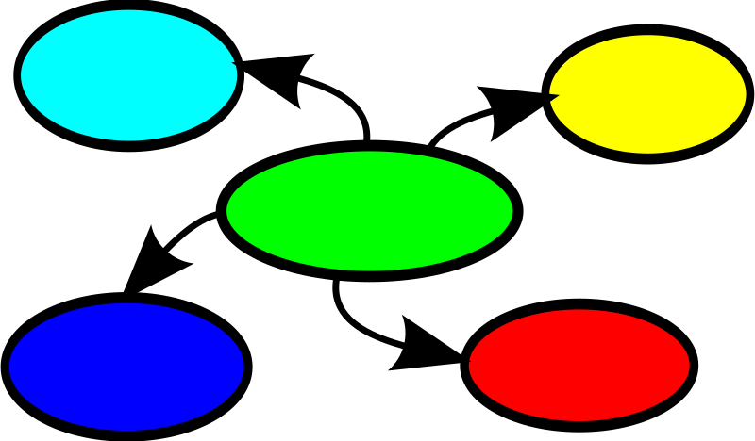
Using Mapping
Brainstorming
Problem Solving
Planning
Reflecting
Visualizing
Notes:
Its purpose is to focus attention, and to capture and frame knowledge to facilitate sharing of ideas and concepts.
Each idea or fact is written down and then linked by lines or curves to its major or minor (or following or previous) idea or fact, thus creating a web of relationships.
The relationships you see in this graphic way, you can uncover ideas for action.

Slide 25
Examples of Data Maps
Logic Model
Flow Chart
Program Mapping Graphic (Program processes, flow of customers through agency programs, etc.)
Outcome scales
Outcome Matrices

Slide 26
Let’s Crunch Some Data
In your groups, take a few minutes to consider the data sets in the handouts.
Determine what type of analysis was used.
Be prepared to present your conclusions.

Slide 27
Data Analysis 2.0 Technique
Factor Analysis
A useful tool for investigating relationships for complex concepts. It enables examination of a number of elements to observe how (or if) they are related.
In factor analysis, multiple observed “variables” are tracked to see if they have similar patterns of responses because they are all associated with a complex concept which cannot easily be measured directly.
For example, people respond to questions about income, education, and occupation (the different variables), which are all associated with “socioeconomic status.”
Notes:
These traditional analysis and program evaluation practices can be much more complicated than are presented in this workshop – when done by statisticians and professional evaluators.
We will try out the techniques using some simplified activities that an agency can do to produce important information that could help them improve their success.

Slide 28
Focuses of ROMA Next Gen
TOC
Data
Results
National Theory of Change
Local Theory of Change
Analysis
Use of Data
Individual / Family
Community Level Results

Slide 29
Individual/Family and Community-Level Outcomes
The National Goals are the “Big Pictures” that are created by targeting agency programs and initiatives to meet local needs which support or create positive changes both in the lives of people and in communities.
ROMA Next Gen tracks services delivered, whether emergency/supportive to foster stability or “bundled” as part of family development programs, and Individual & Family National Performance Indicators (NPIs).
ROMA Next Gen allows us to track community initiatives as the long-term, widely-varied efforts they are.
ROMA Next Gen also establishes links between ROMA and the Organizational Standards by which agencies are evaluated at state- and national-levels.

Slide 30
Next Steps and Questions? Comments?
Next steps:
Get everyone “ROMA-cized”
Increase number of staff in Arkansas who obtain NCRI, NCRT, and FDC certifications
Deliver ROMA Next Gen trainings developed by ANCRT, NASCSP, and the Community Action Partnership – Due late summer or early fall 2017.

