Slide 1
Justice: Economic, Social & Community Arkansas Community Action Agencies Association Annual Conference Fort Smith Arkansas May 18, 2017

Slide 2
Rodney Parks
Rodney O. Parks was named the Senior Director of Major and Planned Gifts at the University of Arkansas - Fort Smith Foundation in August 2015. He leads a staff of six in the areas of planned giving, major gifts, and annual giving. He works closely with the Chancellor, Vice Chancellor of Advancement and the UAFS Foundation Board to manage and execute a comprehensive fundraising plan for UAFS. He provides key leadership for the Foundation's donor relationship goals.
The UAFS Foundation is $80 million in total assets which supports the University of Arkansas - Fort Smith. Mr. Parks' leadership is evident with the following successes to date: 1. Led the creation of UAFS Foundation Giving Societies 2. Rebranded UAFS Foundation Annual Giving Program 3. Led the creation for UAFS monthly eNewsletter called The Roar. 4. Led the rebranding of UAFS Annual MLK Breakfast program. Mr. Parks also manages a principal and major gifts portfolio of 50 donors and leads fundraising efforts for the UAFS College of Business.
Mr. Parks is a 1991 graduate of Arkansas Tech University. He had a successful 20 year banking career before joining Philander Smith College in 2008 as the Director of Development. His highly developed interpersonal skills have led to promotions in positions of leadership and management where he continuously delivers measurable and profitable results. He has held multiple leadership positions such as the former Chairman of the State Banking Board of Arkansas (appointed by Governor Mike Beebe), former member of the Arkansas Tech University Foundation, former Vice President - Leadership of the Association of Fundraising Professionals, a former member of the Little Rock School District Audit Committee, a former trustee of the Arkansas District Judges Retirement System (appointed by Governor Mike Huckabee), and former president of the Arkansas Tech Alumni Association. In 2007, he was chosen to be a member of the inaugural class of the Arkansas State Chamber of Commerce Leadership Arkansas program and was named one of the Arkansas Business “40 Under 40” leaders. He is a member of the Arkansas Black Hall of Fame Foundation. He has contributed his leadership skills to CASE (Council for Advancement and Support of Education): he will receive the Crystal Apple Award for Excellence in Teaching for his stellar speaker reviews from multiple CASE conferences.
He is the founder of Parks Professional Group, a public speaking and management consulting firm. He and Dr. Mary Lackie of UAFS traveled to Pakistan in 2016 to complete a fundraising consultancy for Lahore University of Management Sciences. He is married to his wife Carmen and is the father of twin daughters: Kennedy and Olivia.

Slide 3
Justice

Slide 4
Just-Us

Slide 5
Justice

Slide 6
Justice

Slide 7
Justice
Justice (from Latin jūstitia, meaning
("equivalent to jūst(us)").
Noun - the quality of being just; righteousness, equitableness, or moral rightness

Slide 8
Justice
Today’s Justice Definition (from Rodney O. Parks means “community, social and economic justice that is transparent in public policy and people interactions.

Slide 9
Economic Justice

Slide 10
Social Justice

Slide 11
Community Justice

Slide 12
Be Careful…Look Closer

Slide 13
Justice Means Self Reflection

Slide 14
Justice Means Self Reflection

Slide 15
Justice Means Self Reflection

Slide 16
Justice
I want justice to be the norm not the exception!!!

Slide 17
Questions

Slide 18
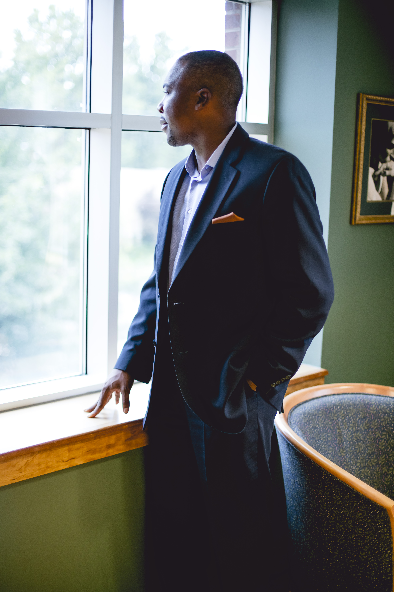
Contact Information
Email
rodney@parksprogroup.com
Phone
501-425-7975
Instagram
RodneyOParks
LinkedIn
RodneyOParks
Twitter
@RodneyOParks

Slide 19
Thank You

