Slide 1
ACAAA Conference May 19, 2017 Ft. Smith, AR
Category Three: COMMUNITY ASSESSMENT

Slide 2
PRESENTERS
Mellissa Allen
Community Action Program for Central Arkansas
Linda Spaul
Central Arkansas Development Council

Slide 3
Goals of This Training
Understand the intent and definition of the standard
Identify materials to document compliance with the standard
Evaluate and benchmark performance compliance with the standard
Access resources to help with compliance and improve performance

Slide 4
WHY DO WE NEED ASSESSMENTS?
To assess gaps in services & identify resources to address
needs
To determine if a particular program is needed
To support organizational strategic planning
To develop program, priorities
To support
the need for funding
To assist with program evaluation

Slide 5
Category Three Standards
3.1- Community Assessment
3.2-Collects Current Data
3.3-Collect and Analyze Both qualitative and Quantitative data
3.4-includes Key Findings on Causes and Conditions
3.5- Accepted by Governing Board

Slide 6
Other Standards to Consider
1.1-Low-income Individuals’ Participation
1.2-Info from Low-Income Individuals
2.2-Info from Key Sectors
2.4-Number of Volunteers and Volunteer Hours
6.4-Customer Satisfaction Data and Customer Input included in Strategic
Planning Process

Slide 7
Overview of TA Guide Structure
Purpose is to:
Assist with definition, intent, and documentation of the Standards
--Section A covers definition and intent
--Section B covers interpretation and documentation
Provide resources to go “beyond compliance”
--Section C provides diagnostic questions
--Section D provides resources

Slide 8
Category Three: Community
Assessment
Considerations for the review process
How is the review connected to processes to document the other standards?
Are there opportunities to connect the review into existing agency processes?
Who should participate?
How will staff determine is Standards are met?
How will the staff document compliance?
How will the staff manage recommendations?
How will the staff archive results?

Slide 9
Category Three: Community
Assessment
Options for going “beyond compliance”:
Short discussion of strengths and opportunities for improvement
Review of resource materials (e.g. guides,
examples of other community assessments)
Interviews/focus group with key staff
Interviews/focus group with outside partners and experts

Slide 10
Standard 3.1
The organization conducted a community assessment and issued a report within the past 3 years.

Slide 11
Standard 3.1
A. Guidance on Definition and Intent of the
Standard
Ensures uniformity across states for the
maximum time period between CNAs
Establishes minimum requirements for the
format and content of the CNA

Slide 12
Standard 3.1
B. Guidance on Compliance and Documentation
“In process” CNAs that begin three years after the previous assessment.
Differences in State requirements for the
frequency of conducting a CNA.
Counting an update to the previous CNA as
complying with Standard 3.1.
What qualifies as “issued” and “report”

Slide 13
Standard 3.1
B. Guidance on Compliance and Documentation
Documentation that the CAA has conducted a CNA within the past three years
Documentation that confirms the CAA issued
a report

Slide 14
Standard 3.1
C. Beyond Compliance
Do the results of the CNA guide development of the CAA’s strategic plan and community action plan?
Do the CAA’s strategies, programs, and services address key
needs identified in the CNA?
Are results from the CNA updated and used to routinely guide decisions about the CAA’s service delivery strategies and programs?
Does the CNA focus on the causes and conditions of
poverty?
Does the CAA use the CNA to engage key community stakeholders and build consensus on a shared policy agenda?

Slide 15
Standard 3.1
D. Resources
National Association of State Community Services Programs (2011). A Community Action Guide to Comprehensive Needs Assessments. http://www.nascsp.org/data/files/CSBG_Resources/Train_Tech_Assista
nce/Needs_Assessment_FINAL_-_8.22_print_to_pdf.pdf
Virtual CAP, Community Needs Assessments – Examples of CAA Needs
Assessment Reports.
http://www.virtualcap.org/project/community-needs-assessments- examples-of-CAA-needsassessment-reports/
Office of Community Services, CCF/SCF Tools for Conducting a Community Assessment.
http://www.virtualcap.org/downloads/VC/US_NA_Examples_TX_Stan dardized_CSBG_Needs_Assessment_2005.pdf

Slide 16
Standard 3.1
D. Resources
Missouri Association for Community Action (2009). Community Needs Assessment Toolkit.
http://www.virtualcap.org/downloads/VC/US_NA_Examples_MACA_Needs_Assessment_T emplate.pdf
Texas Department of Housing and Community Affairs (2005). Standardized CSBG Needs
Assessment.
http://www.virtualcap.org/downloads/VC/US_NA_Examples_TX_Standardized_CSBG_Need s_Assessment_2005.pdf
Office of Head Start, National Center on Program Management and Fiscal Operations, Community Assessment.
http://eclkc.ohs.acf.hhs.gov/hslc/tta-system/operations/mang-sys/planning/planning.html Kansas University, Community Tool Box, Chapter Three: Assessing Community Needs and Resources.
http://ctb.ku.edu/en/table-of-contents/assessment/assessing-community-needs-and-
resources

Slide 17
Standard 3.2
As part of the community assessment, the organization collects and includes current data specific to poverty and its prevalence related to gender, age, and race/ethnicity for their service area(s).

Slide 18
Standard 3.2
A. Guidance on Definition and Intent
Promotes minimum uniform data collection requirements
Ensures CAAs are able to identify the needs of specific vulnerable populations in their community
Improves the efficient use of resources toward a targeted population

Slide 19
Standard 3.2
B. Guidance on Compliance and Documentation
Including one or two, but not all three, demographic categories in the CNA.
Including national and/or state demographic data, but not demographic data for the CAA’s service area.
Using out-of-date demographic data.

Slide 20
Standard 3.2
B. Guidance on Compliance and Documentation
Documentation that confirms collection of poverty data regarding gender, age, and race/ethnicity
Documentation that confirms the data is
current
Documentation that confirms the data is from the entire service area

Slide 21
Standard 3.2
C. Beyond Compliance
Did the CNA compare the demographic data for its current customers with data from the broader service area?
Did the report include a geographic comparison between
locations within the service area?
Does the CAA update the demographic data from its CNA on an annual basis?
Does the CNA combine different demographic categories to produce a more detailed picture of the conditions of poverty in the community?
Does the CNA include demographic data at the neighborhood and/or census tract level?

Slide 22
Standard 3.2
D. Resources
Community Commons, Community Action Partnership’s Comprehensive Community Needs Assessment Tool. http://www.communitycommons.org/groups/community-action-
partnership/
New York State Community Action Association, Needs Assessment
Tool.
http://needsassessment.nyscommunityaction.org/ Annie E. Casey Foundation, Kids Count Data Center.
http://www.aecf.org/work/kids-count/kids-count-data-center/
United State Census, American Fact Finder.
http://factfinder.census.gov/faces/nav/jsf/pages/searchresults.xhtml?r efresh=t

Slide 23
Standard 3.3
The organization collects and analyzes both qualitative and quantitative data on its geographic service area(s) in the community assessment.

Slide 24
Standard 3.3
A. Guidance on Definition and Intent
Ensures effective analysis of data
Ensures use of comprehensive, integrated data
Ensures analysis of service area in its entirety

Slide 25
Standard 3.3
B. Guidance on Compliance and Documentation
How the State defines collect and analyze.
How the State defines the amount of qualitative and quantitative data.
Uniformity of data collection across the
service area.

Slide 26
Standard 3.3
B. Guidance on Compliance and Documentation
Data collection procedures
Data analysis procedures
Quantitative and qualitative data
Coverage of the service area

Slide 27
Standard 3.3
C. Beyond Compliance
Does the data include trends from the last three or more years?
Is the data updated annually?
Is the data presented in a way that is accessible to the general public?
Does the CAA use the data collection process to build connections with broader stakeholder groups?

Slide 28
Standard 3.3
D. Resources
Community Commons, Community Action Partnership’s Comprehensive Community Needs Assessment Tool. http://www.communitycommons.org/groups/community-action-
partnership/
New York State Community Action Association, Needs Assessment
Tool.
http://needsassessment.nyscommunityaction.org/ Annie E. Casey Foundation, Kids Count Data Center.
http://www.aecf.org/work/kids-count/kids-count-data-center/
United State Census, American Fact Finder.
http://factfinder.census.gov/faces/nav/jsf/pages/searchresults.xhtml?r efresh=t

Slide 29
Standard 3.3
D. Resources
Survey Monkey, Smart Survey Design http://s3.amazonaws.com/SurveyMonkeyFiles/SmartSurvey.p df
Wider Opportunities for Women, Basic Economic Security
Tables
http://www.basiceconomicsecurity.org/gateway.aspx Massachusetts Institute of Technology, Living Wage Calculator http://livingwage.mit.edu/
National Low-Income Housing Coalition, Out of Reach http://nlihc.org/oor

Slide 30
Standard 3.4
The community assessment includes key findings on the causes and conditions of poverty and the needs of the communities assessed.

Slide 31
Standard 3.4
A. Guidance on Definition and Intent
Ensure that CAAs focus on the root causes of poverty in order to prioritize self-sufficiency over service delivery.
Encourage dissemination of a succinct analysis of needs in the community to relevant partners, stakeholders, and funders

Slide 32
Standard 3.4
B. Guidance on Compliance and Documentation
Lack of a clearly identified key findings section.
Inclusion of the conditions of poverty but no
documented discussion, or analysis of the causes.
Assessment of causes and conditions of poverty currently addressed by the CAAs programs, but not those of the broader service area.

Slide 33
Standard 3.4
B. Guidance on Compliance and Documentation
Key findings section

Slide 34
Standard 3.4
C. Beyond Compliance
Is the analysis of the causes and conditions of poverty grounded in the quantitative and qualitative data collected by the CNA?
Were the causes and conditions analyzed multiple levels?
Does the CAA engage other stakeholders in the
analysis of the causes and conditions of poverty?
Does the CAA have a theory of change?

Slide 35
Standard 3.4
D. Resources
Community Commons, Community Action Partnership’s Comprehensive Community Needs Assessment Tool. http://www.communitycommons.org/groups/community
-action-partnership/
New York State Community Action Association, Needs Assessment Tool. http://needsassessment.nyscommunityaction.org/
Annie E. Casey Foundation, Kids Count Data Center.
http://www.aecf.org/work/kids-count/kids-count-data- center/

Slide 36
Standard 3.5
The governing board formally accepts the
completed community assessment.

Slide 37
Standard 3.5
A. Guidance on Definition and Intent
Ensures board involvement in the CNA

Slide 38
Standard 3.5
B. Guidance on Compliance and Documentation
Defining what “board formally accepts” means.
Remaining in compliance with the 3 year time
period.

Slide 39
Standard 3.5
B. Guidance on Compliance and Documentation
Board approval

Slide 40
Standard 3.5
C. Beyond Compliance
Does the board have a committee or similar structure with responsibility for the CNA?
Is the board briefed about the findings of the
CNA?

Slide 41
Standard 3.5
D. Resources
Community Action Partnership, Schedule of Actions for Boards http://www.communityactionpartnership.com/storage/cap/documents/OSCOE/schedule_of_sta ndards_final_fillable.pdf
Community Action Partnership, Organizational Standards and Community Action Boards http://www.communityactionpartnership.com/storage/cap/documents/OSCOE/standards_and_b oards_final.pdf
Community Action Partnership, COE-Developed Organizational Standards – What Do Boards Need to Know (video) https://www.youtube.com/playlist?list=PLMVDY93WCekqzYtF_TUostM98dBD1il3T
CAPLAW (2011). Tools for Top Notch CAAs: A Practical Approach to Governance and Financial
Excellence
(Part II in Topic 1). http://www.caplaw.org/resources/PublicationDocuments/TopNotchToolkit.html

Slide 42
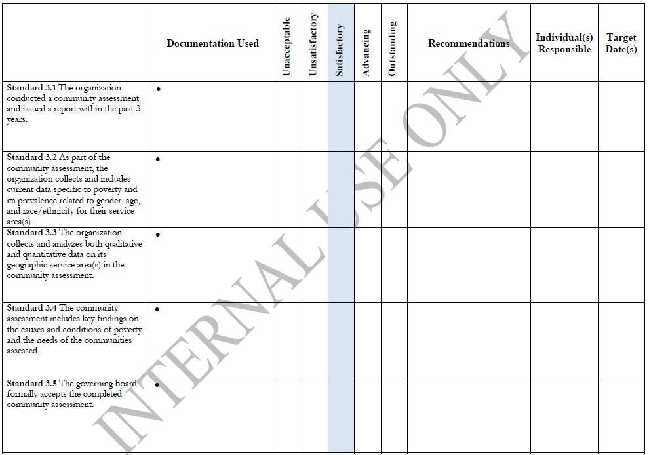
Standards Review Worksheet
Template

Slide 43
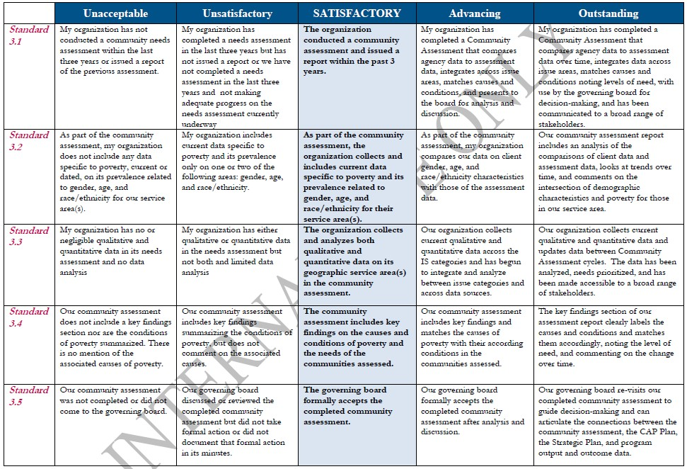
Assessment Scale

Slide 44
QUESTIONS

