Slide 1
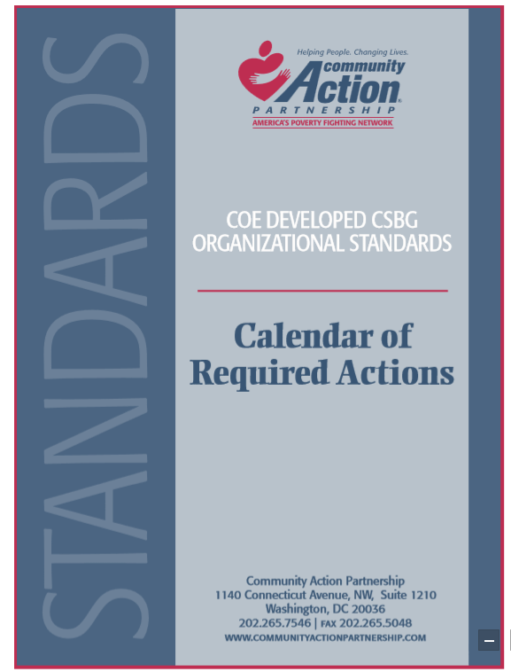
Calendar of Required Actions
Annually
Every 2 Years
Every 3 Years
Every 5 Years
Documentation

Slide 2
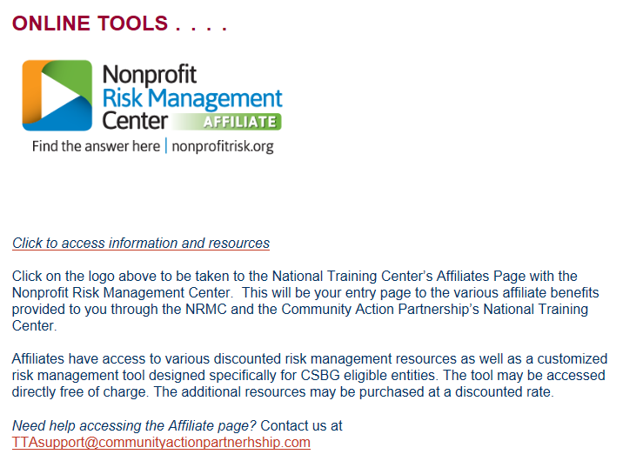
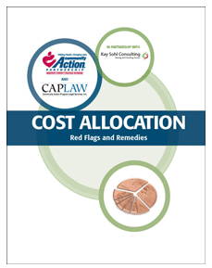
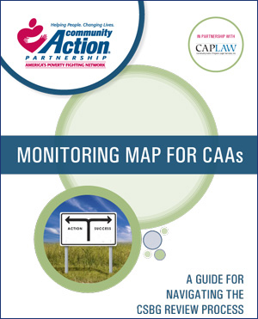
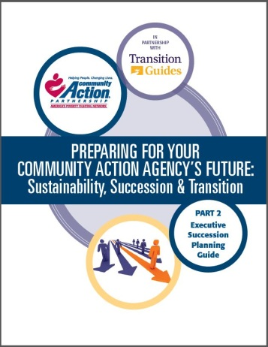
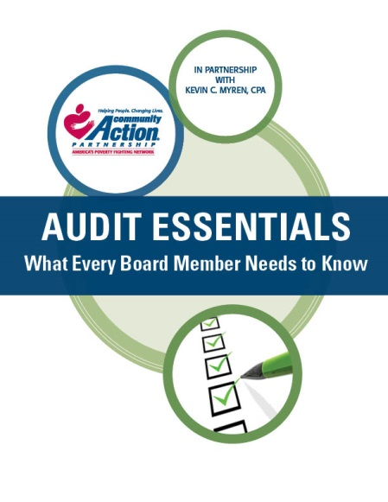
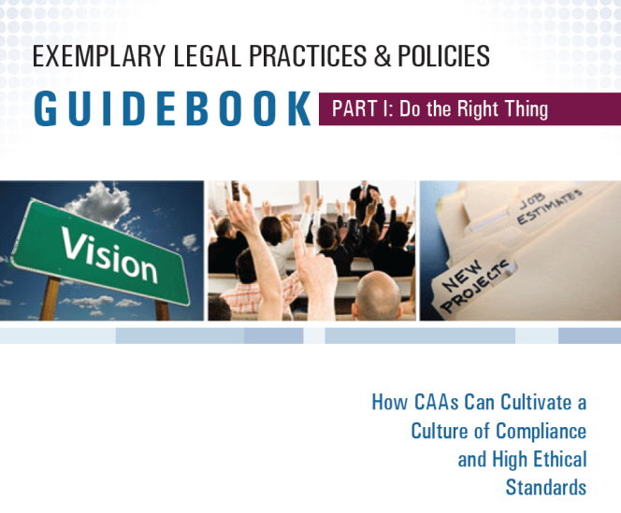
Tools Already Available to Help CAAs Meet the Standards

Slide 3
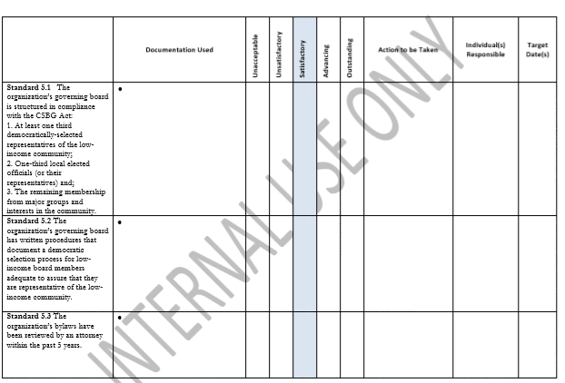
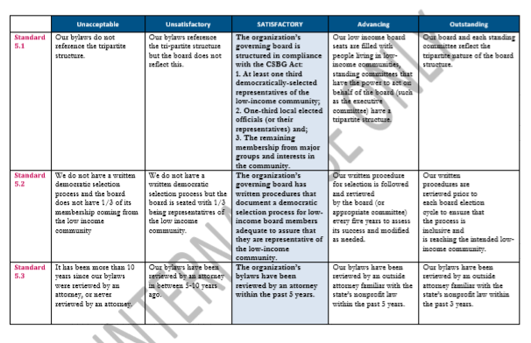
Assessment Scales
For Internal Use by CAAs Only
Moving Beyond Compliance
Accompanying webinars

Slide 4
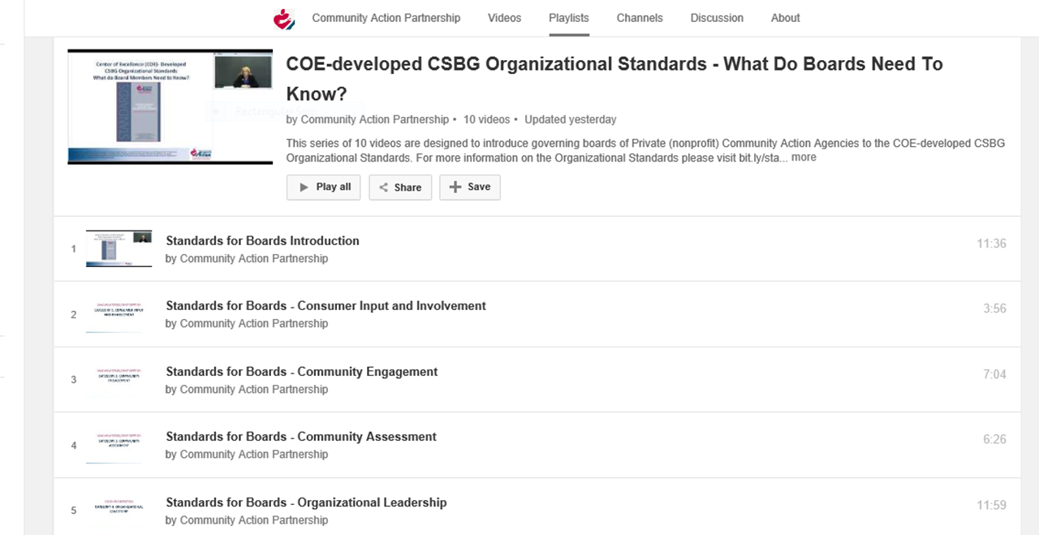
Boards of Directors/Advisory Boards
Handouts
Videos

Slide 5
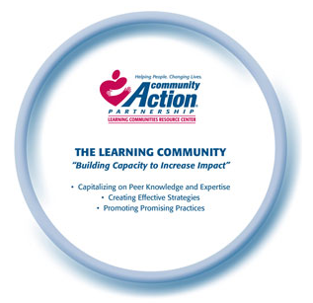
Learning Community Resource Center
Closed
Financial Empowerment
Results at the Community Level
Trauma Informed Approaches
Bundling Services
Open
Health Intersections
Poverty Trends
Decreasing Family Homelessness

Slide 6
Rural IMPACT Year 1 Implementation Overview

Slide 7
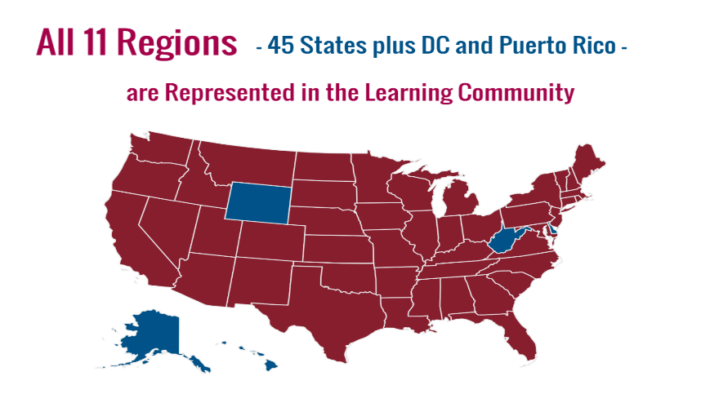
Learning Community Members—1185 And Counting!

Slide 8
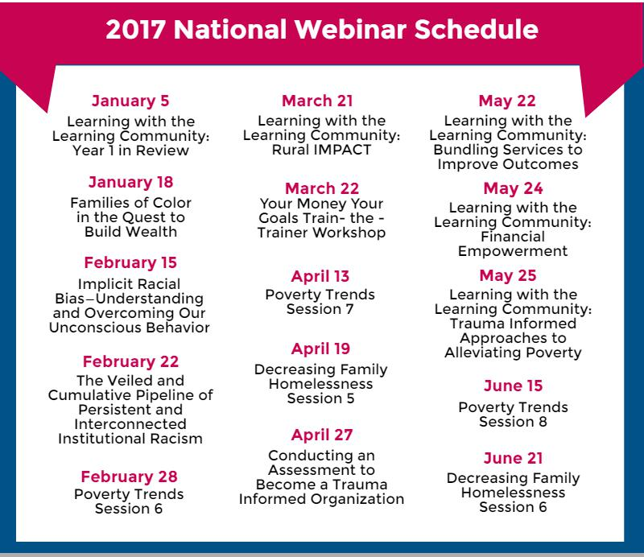
2017 National Webinar Series Schedule

Slide 9
Learn With The Learning Community
Follow Our New Blog at: lcrcweb.com

Slide 10
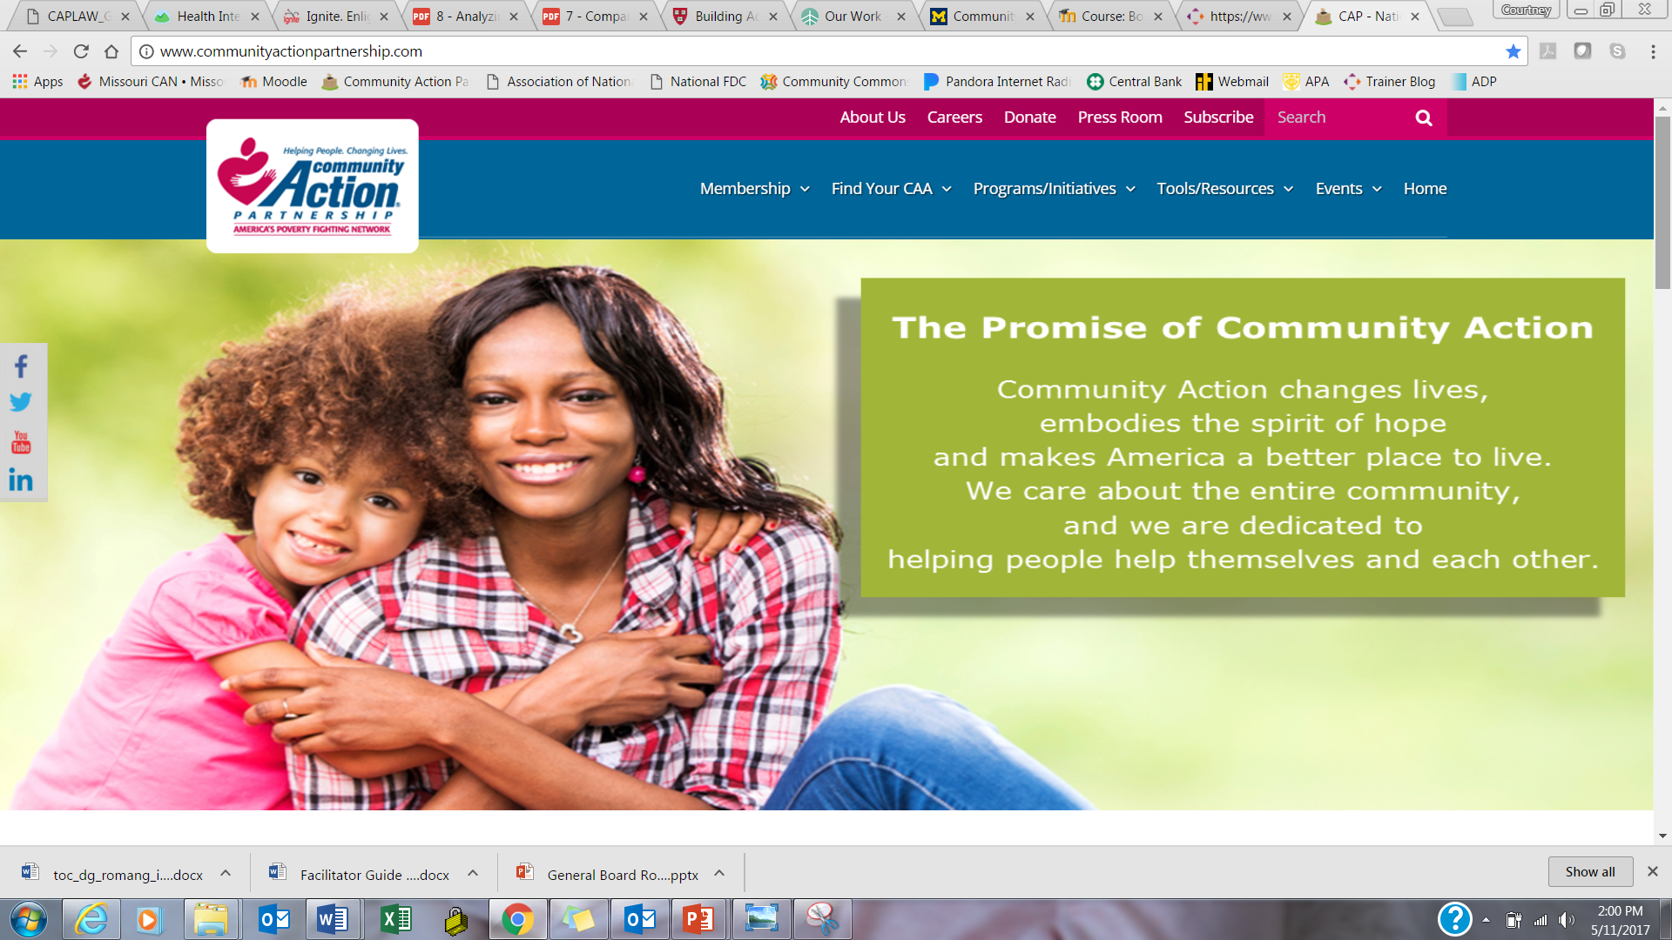
www.communityactionpartnership.com

Slide 11
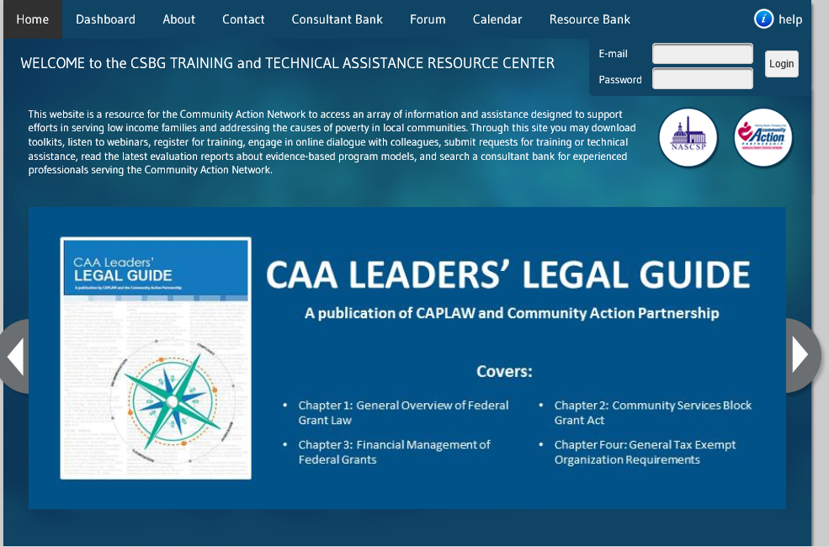
CSBG T/TA Resource Center
www.csbgtta.org
Many more toolkits, webinars, and print resources
Consultant Bank
Training Calendar
Discussion Forum
Shared Calendar

Slide 12
2017 Annual Convention
Community Action: Transforming Communities, Changing Lives
August 29th – September 1st
Join us in Philadelphia for valuable training, legislative information, timely program updates, and unparalleled networking!
Philadelphia Downtown Marriott - Philadelphia, PA
www.communityactionpartnership.com

Slide 13
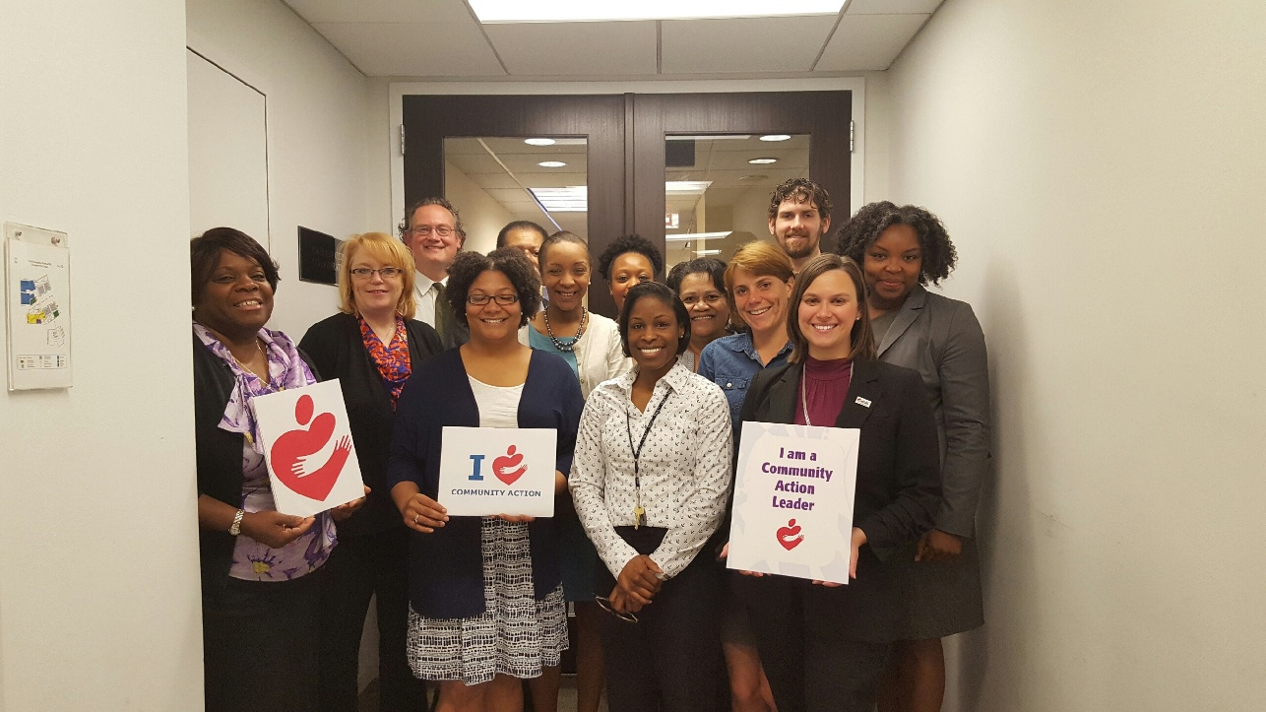
Contact Information
Courtney Kohler
Senior Associate, Training and Technical Assistance
ckohler@communityactionpartnership.com
Many of the publications , training, and webinars mentioned were created by the National Association of Community Action Agencies – Community Action Partnership, in the performance of the U.S. Department of Health and Human Services, Administration for Children and Families, Office of Community Services Grant Number 90ET0428, 90EQ0231, 90ET0434, 90ET0436, 90ET0437, and 90ET0445. Others were created by the Community Action Program Legal Services, Inc. (CAPLAW), in the performance of the U.S. Department of Health and Human Services, Administration for Children and Families, Office of Community Services Grant Number 90ET0429 and 90SQ0047. Any opinion, findings, and conclusions, or recommendations expressed in this material are those of the author(s) and do not necessarily reflect the views of the U.S. Department of Health and Human Services, Administration for Children and Families.

