Slide 1
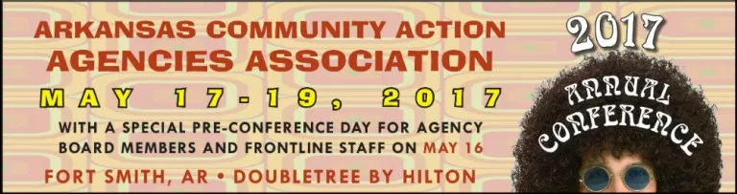
ACAAA Annual Conference 2017
Community Action Partnership Update
Presented by:
Courtney Kohler
Community Action Partnership
Washington, DC – Missouri Remote Office
ckohler@communityactionpartnership.com

Slide 2
Community Action Partnership's Three Key Focus Areas
Advocacy
Training & Technical Assistance
Visibility

Slide 3
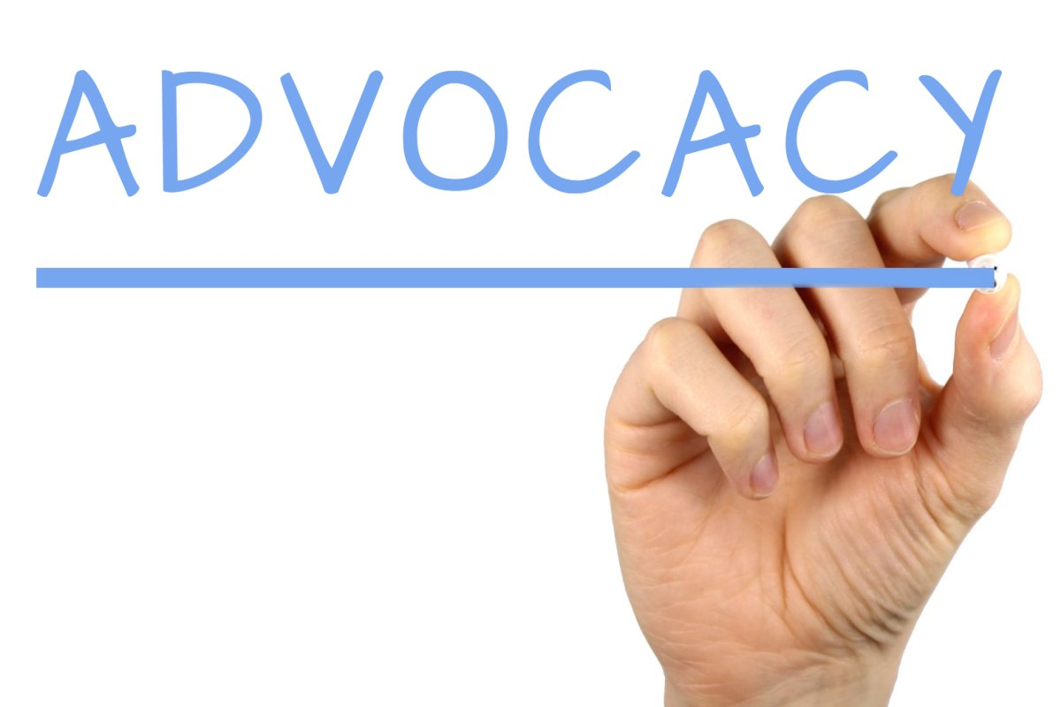
Advocacy

Slide 4
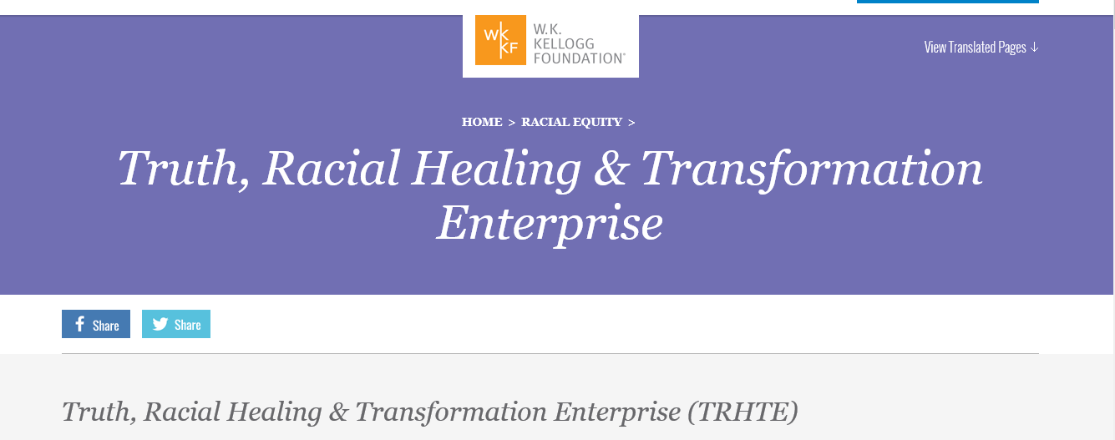
Advocacy

Slide 5

What is TRHT?
The W.K. Kellogg Foundation-led Truth, Racial Healing &Transformation (TRHT) enterprise is a national and community-based process to engage communities across the U.S. in racial healing and change efforts.

Slide 6
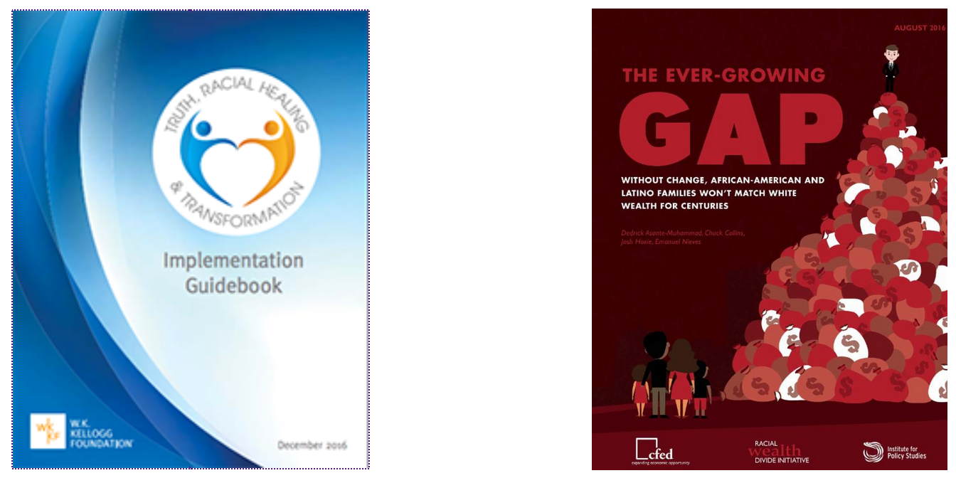
RESOURCES YOU CAN USE
Truth Racial Healing and Transformation Implementation Guide | The Ever-Growing Gap: Without Change, African-American and Latino Families Won't Match White Wealth for Centuries
Please watch this overview video from the
2016 National Summit

Slide 7



Slide 8


Branding and Communication
Focused eNews
Branding Summit
Tools and Resources
Social Media

Slide 9
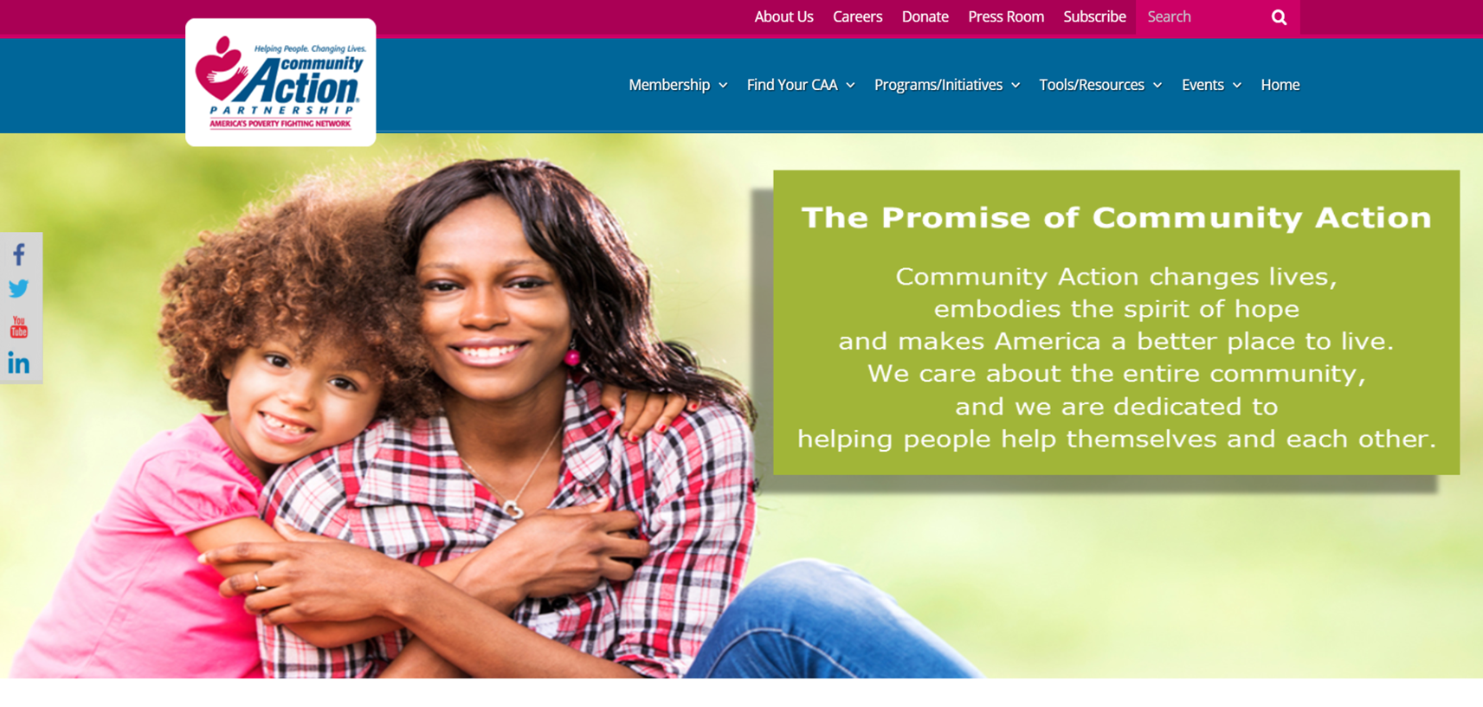
New Website! www.communityactionpartnership.com

Slide 10



Slide 11
T/TA Efforts
Organizational Standards Center of Excellence
  Regional T/TA Initiatives
  New T/TA Resources
Learning Communities Resource Center
  Seven Learning Communities Groups
  Rural IMPACT Project
Training Workshops
  New ED Bootcamp
  Needs Assessments and Strategic Planning

Slide 12
Tools and resources To assist with organizational Standards

Slide 13
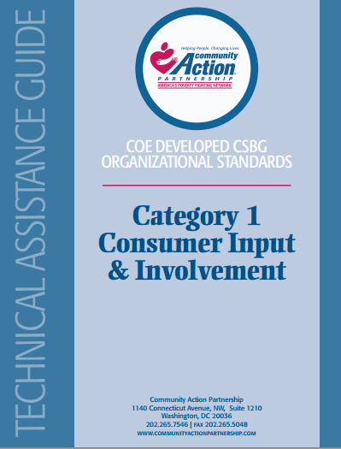
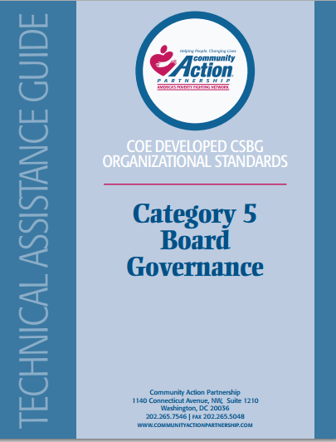
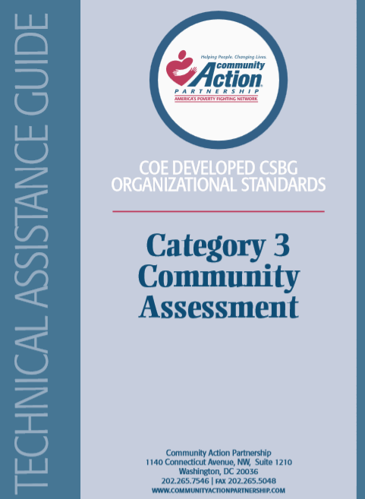
Toolkits and Webinars for Each of the Nine Categories
Additional Guidance
  Definition
  Compliance
  Document
Beyond Compliance
Resources
Assessment Scales

