Slide 1
Community Action Agency
Board Governance
May 16, 2017
Courtney Kohler, CCAP, NCRT
ckohler@communityactionpartnership.com Senior Associate, T/TA - Community Action Partnership

Slide 2
Introductions
Name
Agency
Role on Board
Why did you become a board member?

Slide 3
Agenda
CAA Board Basics
Roles & Responsibilities – Recruitment & Orientation
- - - - - Lunch Break - - - - - - - - -
Roles & Responsibilities – Duties, Standards, & Rights
Leadership & Engagement:
Community Needs Assessment
Strategic Planning
Monitoring
Fiscal
Big Picture: Board Cliff Notes
ROMA Next Generation
Organizational Standards

Slide 4
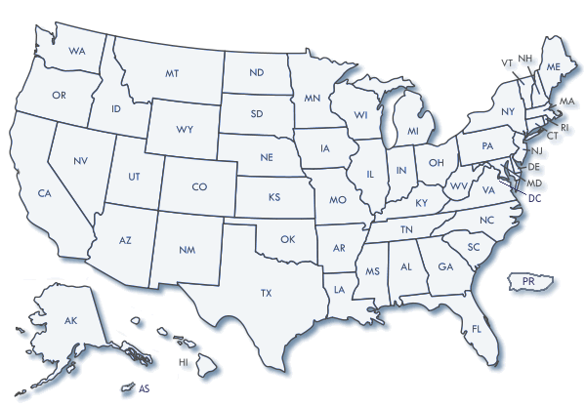
The Partnership
1000+ Agencies | 44 State Associations | 15 million served
Community Action changes people’s lives, embodies the spirit of hope, improves communities and makes America a better place to live. We care about the entire community and we are dedicated to helping people help themselves and each other.

Slide 5
Promise of Community Action
Community Action changes people’s lives, embodies the spirit of hope, improves communities, and makes America a better place to live. We care about the entire community, and we are dedicated to helping people help themselves and each other.
Notes:
Together we can fulfill the promise of community action

Slide 6
Board Basics
CAA Board Governance

Slide 7
What makes you a Community Action Agency?
Has received designation as a CAA from local or state government
Is recognized as an eligible entity by CSBG Act and can receive funding from the state under CSBG;
Tripartite Board; and
Belongs to a national and state network of similar agencies.
Notes:
Before we dive into the specific responsibilities, its important to give context to the work you do. For more on context and history of community action, you may refer to the “History of Community Action” training module that is located in the moodle learning management system.
So what makes up a Community Action Agency?
The CAA has received designation as a caa from local or state government and you are recognized as an eligible entity by the csbg act by receiving csbg funds.

Slide 8
Why CAAs Are Unique
CAAs:
Revitalize Communities
Empower Families
Reduce Poverty
Flexibility
Immediacy
Community Catalyst and Coordination
Notes:
Together, we are able to revitalize community, empower families and reduce poverty! We can equips low income individuals with the tools and potential for becoming self-sufficienct.
We have a coordinated effort to address the root effects of poverty and to, ultimately, move families and individuals to self sufficiency.
This work is not easy and demand is always shifting and changing but we do have several key components that make us who we are: we are flexible
Flexibility- CSBG is unique, it is flexible, and it primarily funds local investments in services, facilities and partnerships which are particular to the CAAs home community. Communities can provide its low income members the right mix of assistance, encouragement and incentives to become self sufficient.
We can respond immediately to needs. Take the tornado that hit Joplin a few years ago, Economic Security Corporation was there to meet the immediate needs of the community as well as spearhead the rebuilding efforts.
We are also a community catalyst who coordinates community members to create change
CAAs can revitalize communities, empower families and reduce poverty.
A CAA with All its programs working together can make a difference.
CAAs are comprehensive and serve as a catalyst.

Slide 9
Community Action Agency’s Mode of Operation
Community needs assessments
Anti-poverty plans & strategies
A range of direct services
Mobilization of resources
Advocacy on behalf of families with limited resources
Partnerships with other community-based organizations
Tri-partite Board
Notes:
There are certain requirements that each community action agency must conduct in order to receive community services block grant funds…
They must complete a community needs assessment to get a pulse of what is going on in their community so that they can create the most appropriate anti poverty plan and strategies for both the community and the individuals. Community action agencies must conduct a range of direct services for their community and as stated earlier, mobilize all available federal, state, local and private resources for their community. Community action agencies must advocate on behalf of families with limited resources and partner with other community based organizations to ensure that all needs of the community are met.
CAAs must also have a tri partite board, which is a structure where the board includes:
1/3 who are democratically elected low-income representatives
1/3 local public officials or their designees, and
1/3 private sector partners such as business, education, non-profit, etc.

Slide 10
Rules Governing Tripartite Boards
Federal CSBG Act & regs
(42 U.S.C.
§ 9910)
CSBG contract with state
For some states,
State CSBG statute & regs
CAA Boards
CAA’s Articles of Incorporation & Bylaws
If applicable, Head Start Act
(42 U.S.C. § 9837(c)(1))
State Nonprofit Corp. Act
Notes:
Federal CSBG Act and regulations
State CSBG statute and regulations
For CAAs with Head Start, the federal Head Start Act and regulations
State nonprofit corporation statute
Set minimum standards of compliance and “default” rules
Provisions of articles or bylaws not consistent with the act have no legal effect
For private non-profit CAA’s, the Articles of incorporation and Bylaws
Filing with Secretary of State that creates the nonprofit corporation
CSBG grant or contract provisions

Slide 11
Federal CSBG Act: Purposes & Goals
Reduce poverty
Revitalize low-income communities
Empower low-income families and individuals to become fully self-sufficient
Notes:
Since the board of directors of a CAA is ultimately responsible for defining the agency’s mission and programs and setting organization-wide policy, it’s important to keep in mind the historic mission of the CSBG Act in the context of community action agencies.
The purposes and goals of the CSBG Act are to assist states and local communities, working through a network of community action agencies and other neighborhood-based organizations, to:
Reduce poverty
Revitalize low-income communities
Empower low-income families and individuals to become fully self-sufficient

Slide 12
Federal CSBG Act: Purposes & Goals
Strengthening community capabilities for planning
Leveraging the resources of other anti-poverty programs
Coordinating resources responsive to local needs and conditions
Achieve These Goals By
Maximum participation of low-income communities
Organizing services to have a measurable impact on causes of poverty
Using innovative approaches to attack causes and effects of poverty
(42 U.S.C. § 9901)
Notes:
The CSBG Act envisions achieving these goals by:
Strengthening community capabilities for planning;
Coordinating the use of a broad range of Federal, State, local, and other anti-poverty resources to be responsive to local needs and conditions;
Organizing a range of services related to the needs of low-income families so as to have a measurable and potentially major impact on the causes of poverty and to help individuals achieve self-sufficiency;
Using innovative and effective community-based approaches to attacking the causes and effects of poverty;
Maximum participation of residents of the low-income communities; and
Leveraging the resources of other anti-poverty programs—
Private, religious, charitable, and neighborhood-based organizations; and
Individual citizens, and business, labor, and professional groups, who are able to influence the quantity and quality of opportunities and services for the poor.
(42 U.S.C. § 9901)

Slide 13
Guidance on Tripartite Boards
IM #82: Tripartite Boards
Selection and composition requirements
Roles and responsibilities
IM #138:
CSBG Organizational Standards
OCS-recommended as performance management initiative
Proposed timeline for states to adopt Standards
Notes:
In addition to federal and state CSBG statutes and regulations,
OCS publishes Information Memoranda (IM) to provide guidance and to assist CAA’s in implementing the CSBG Act.
Guidance is non-binding, but nevertheless is a good indication of OCS’ interpretation of the federal CSBG Act and regulations.
Information Memorandum 82 (which speaks to tripartite board selection and composition requirements) and IM 138 (which speaks to the new CSBG organizational standards, which touch upon board roles and responsibilities)
IM #82
Covers the selection and composition requirements for the tripartite board, including the democratic selection procedures for the low-income sector board members.
Also discusses the roles and responsibilities of the tripartite board as outlined in the federal CSBG Act.
IM #138 – discussed on next slide.

Slide 14
The Importance of Community Action
Community Action’s success is not measured by services, but by improvements in the lives of the people served, and no less importantly— in changes in community attitudes and practices toward the challenge of poverty.
- OEO Director, Donald Rumsfeld, 1970
Notes:
Community Action is important and being on a CA Board, I feel confident that you agree. Because of this importance, we must show how community action success is not measured by services, but by improvements in the lives of the people served, and no less importantly, in changes of the community attitudes and practices toward the challenge of poverty.
The CAA board plays a huge role in not only the planning, but the outcomes and successes in the lives of the people served. Next, we will discuss this role in more depth, including the 2-way investment of a board member and what effective governance truly means.

Slide 15
Roles & Responsibilities
CAA Board Governance

Slide 16
What does dating have to do with board membership?
They both start with the right match – the organization will be best benefited by an individual with matching goals and talents.
Successful relationships involve open communication and being honest about one’s needs.
Both begin with a match, followed by an interview to determine if the match is worth pursuing.
Being able to say “thanks, but no thanks” to a mismatch, may be awkward at first, but best for both parties in the long term.
Wallestad, Anne. 2013. "What online dating can teach us about boards" Exceptional Board Blog - www.exceptionalboards.com

Slide 17
A Two-Way Investment
"Board members who plan and ask for what they want in a board will contribute more, as well as gain more." -managementhelp.org
Board investment = time, energy, money, creativity, skill...
One must be in for the ups and downs
Each member is representing the home agency, as well as the nationwide network.
At the start of service to the board, not only is there a hope of collective difference because of individual contributions, but each individual should walk away feeling individual and organizational growth.
Notes:
Is Board Work Right for Me? HANDOUT

Slide 18
“What contribution would you like to know you've had at the end of service on the board?”

Slide 19
The Board’s Purpose
To direct the mission and purpose of the agency
Provide accountability
Liaison between community and the agency

Slide 21
Board Selection
Board members are to be chosen by the board (for nonprofit CAAs) or governing officials (for public CAAs), subject to the democratic selection process for the low-income sector
Recommendation
Have board members elected by full board (for nonprofit CAAs) or governing officials (for public CAAs) once chosen through appropriate selection process
Notes:
Some general things before getting into specifics of each sector
Fed act requires board to be chosen by board
Can make this jive with democratic selection by doing election, then as final step, board votes to seat elected individual
Note that state laws could add stricter residency requirements

Slide 22
Tripartite Boards – Composition and Selection
Remainder: Private Sector
At least 1/3: Low-Income sector
1/3: Public Officials
Standard 5.1: Nonprofit/Public
The org.’s governing board/advisory body is structured in compliance with the federal CSBG Act.
Standard 5.5: Nonprofit/Public
Governing board/advisory body fills board vacancies as set out in its bylaws
Notes:
Ask audience: what sector are you from?
Purpose of CSBG Act’s tripartite board requirement is to get perspectives and input from the various sectors – low-income, public officials and “private” – on community needs, resources and effectiveness of programs.

Slide 23
Public Sector
CSBG Act says “holding office at time of selection”
OCS IM 82 recommends that public officials serve only while they are in office
Recommendation
Have specific terms rather than permitting public officials to stay on the board as long as they are in public office
Notes:
In some cases, conflict of interest rules make it preferable for public officials to designate representatives (e.g., state and local ethics or conflict of interest rules or HUD conflict of interest rules may affect whether public officials can serve on a CAA’s board and what they can do as board members)

Slide 24
Low-Income Sector
Should represent current low-income residents, but don’t need to be low-income themselves
Recommendation
Have at least some, if not all, low-income board members who are low-income themselves
Notes:
…because if you want the low-income voice on your board, there’s no better way to do that than through low income folks themselves

Slide 25
Private Sector
Grantee may choose representatives from organizations or individuals
Recommendation
If choosing reps from org, board has more flexibility if bylaws don’t specify which orgs
Notes:
Looking for groups and interests with “current influences” or resources deemed “critical” to success of agency represented.

Slide 26
Board Size
Look at board size and decide on right number of board members
Federal CSBG Act does NOT address board size
Some states’ CSBG law and/or regs impose board size requirements
Notes:
Board size – Is board too big? If so, consider amending bylaws to reduce size. Appropriate size depends on CAA’s circumstances (e.g. size of organization, number of programs, geographic area served etc.). Best practice: 15-30 board members.
Don’t want to have too many board members – can make it difficult to provide notice of/get a quorum at meetings, can increase board’s reliance on management and lessen management’s accountability to board.
On other hand, don’t want to have to few board members – harder to get community participation, input; harder to spread work around, can also lessen accountability if only a few people are making decisions. Board can decide to leave it flexible, provide a range in the bylaws (ex. 15-24 with specific number set each year by the board)

Slide 27
Board Members’ Terms
Federal CSBG Act does NOT address CAA board terms or term limits
Bylaws should state board members’ terms
If the bylaws are silent, state nonprofit corporation law may set a default term (e.g., 1 year)

Slide 28
Strategies for Board Recruitment
Use case managers to identify potential board members
Have an active communication/social media strategy advertising opportunities
Recruit volunteers to serve in an advisory capacity on board committees
Hold an annual community forum

Slide 29
Strategies for Board Recruitment
Provide leadership and community organizing training to customers and neighborhood residents
Develop recruitment materials for front line staff to distribute
Recruit from natural constituencies (e.g. Head Start parents, school districts, neighborhood associations)
Build connections to other public, nonprofit, and private service providers

Slide 30
Strategies for Board Retention
Be clear about board responsibilities during recruitment
Provide adequate orientation and training, especially on “board basics”
Actively solicit input from new board members and be intentional about providing opportunities to participate

Slide 31
Strategies for Board Retention
Use mentors
Use the press and social media to recognize contributions of new board members
Think about the “extras” – child care, meals
Conduct board assessments to identify challenges and concerns

Slide 32
Orienting New Board Members
Most Board members report that it takes a while to get “the lay of the land” and figure out how things work. The formal orientation process will help provide some background information and the onboarding process will focus more on the interpersonal part of board service.
The Board President and the Executive are not the only people who help with onboarding. All Board members should consider themselves “ambassadors” and should work to help new members become integrated.

Slide 33
Orientation Components: Organizational Documents
Background & Finance:
Annual Report
Program Information
Budget
Audit or Financial Review
990 Form
Strategic Plan
Board Meeting Agenda & Minutes
Organization Chart or Staff List
Notes:
Facilitator’s Notes / Discussion Points:
Caution workshop participants to be very careful in the way they share this information so that the new Board member does not get overwhelmed. Some organizations choose to share some of this information during the recruitment process rather than waiting until someone has officially been elected to the Board. This should be discussed by the E.D. and Governance or Nominating Committee in advance. Potential Board members may like to see the annual report, some basic program information, the budget and the strategic plan during the initial recruiting conversations.
It is not necessary to share all eight items listed on this slide during the orientation process if the Board has a regular schedule for reviewing some of these documents. For example, the Board may have a practice of reviewing and discussing the 990 Form prior to its submission to the government. Since this document is quite long, many Boards choose to review it during a Board meeting and do not include it in the early orientation meeting.

Slide 34
Orientation Components: Board Documents
Board Member Agreement/Covenant
By-Laws
Conflict of Interest Policy
Document Retention & Destruction Policy
Whistleblower Policy
Board Roster
Board Calendar
Board Norms
Job Description
Notes:
Facilitator’s Notes / Discussion Points:
Caution workshop participants to be very careful in the way they share this information so that the new Board member does not get overwhelmed. Some organizations choose to share some of this information during the recruitment process rather than waiting until someone has officially been elected to the Board. This should be discussed by the E.D. and Governance or Nominating Committee in advance. For example, potential Board members may like to see the Board member job descriptions or the agreement/covenant, the board calendar and the board norms during the recruitment process.
It is not necessary to share all this information during the orientation process if the Board has a regular schedule for reviewing some of these documents.

Slide 35
Job Description – A Key Tool
This document can serve as the foundation for orienting new Board members.
A formal written Job Description should be developed and approved by the Board.
Start with a sample description & customize it for your agency.
Notes:
An activity on board member job descriptions is located in the facilitator guide section of this training module. A sample job description is also in the handout section.

Slide 36
Lunch
See you back at 2pm!

Slide 37
Board Responsibilities
Set Direction
Ensure Necessary Resources
Provide Oversight
Tend to Board Structure & Operation
handout
Adapted by Nonprofit Services Center from BoardSource, Assessment of Governing Boards Practitioner Program, Presented by Berit M. Lakey, PhD. 2010
Notes:
Board Responsibilities Chart HANDOUT
There are many, many lists of responsibilities for Board Members. After comparing many different models, it seems that using this framework from BoardSource makes the concept easier to understand. These 4 buckets of responsibility will incorporate every item on all the lists reviewed in preparing this guide.

Slide 38
#1: Set Direction
Define Purpose & Mission
Establish a Vision for the Future
Ensure Necessary Planning
Notes:
Facilitator’s Notes / Discussion Points:
The Board has the overarching responsibility to define the agency’s purpose and mission. As part of a larger state and national organization, it may be that the stated purpose and mission of the agency are already defined at a basic level. The challenge for the local agency board is to determine how the purpose and mission will “come to life” in the local setting.
The Board is legally responsible for the agency’s sustainability. Planning makes it possible for the agency to chart a path of health and growth and makes it possible to develop a shared understanding of agency mission, strategy and operations.

Slide 39
#2: Ensure Necessary Resources
Financial
Human – Perpetuating the Board
Human – Hiring, supporting & evaluating the Executive Director
Serve as Ambassadors & Protect the Organization’s Reputation in the community
Notes:
Facilitator’s Notes / Discussion Points:
The Board is responsible for upholding the public trust which accompanies the tax exempt status awarded by the government. As stewards of this trust, the Board is responsible for:
The financial health of the agency. The Board is legally liable for the financial stability/soundness of the agency. Most Boards work in collaborative partnership with the Executive to ensure the financial health of the agency.
The Lodestar Model is a sustainability model that our Development Director here at MACA endorses. If you’d like more information on Resource Development for your Board, or the Lodestar Model, contact Jeff Barlow at the Missouri CAN Office.
Ensuring that ongoing oversight of the agency is provided by the Board. This translates to a need for the Board to insure that the new members are recruited and that the Board meets the obligations and expectations outlined in the agency by-laws. Most Boards work in collaborative partnership with the Executive to build and sustain the board.
The Board employs one person: the Executive Director. All other agency staff are employed by the Executive. Usually the Board Chair or President is the primary point of contact for the Board with the Executive. Support of the Executive should be provided by the entire Board & the Executive’s annual performance appraisal should be completed by the Personnel Committee of the Board. Usually, the Board President delivers the appraisal feedback to the Executive, though practices vary by agency.
Each Board member should consider him/herself to be a public ambassador for the agency – promoting the agency in the community & serving as a positive representative of the agency. Board members can play a very important role in preserving & enhancing the agency’s good reputation in the community.

Slide 40
#3: Provide Oversight
Program
Finances
Legal & Ethical
Values & Culture
Notes:
Facilitator’s Notes / Discussion Points:
The Board is responsible for upholding the public trust which accompanies the tax exempt status awarded by the government. As stewards of this trust, the Board is responsible for:
Programmatic oversight – this does NOT mean micromanaging programs. It refers to the high level oversight needed to insure that programs fit the mission of the organization and that the overall program balance (in terms of funding) creates a sustainable model rather than one which continuously drains resources by being underfunded.
Financial oversight – again this is high level oversight to insure that financial systems & controls are in place and that operations are fiscally sound. The Board should review financial reports regularly as well as the audit and the 990 form.
Financial Management HANDOUT
Legal & Ethical – the Board maintains primary responsibility for insuring that agency matters are legally compliant and ethically sound. Policies and procedures should be in place and reviewed regularly.
CAPLAW Toolkit
Values & Culture – as primary ambassadors for the agency, Board members need to be able to articulate the agency values as well as build a strong, healthy agency culture at the Board level.

Slide 41
#4: Tend to Board Structure & Operation
Size & Composition
Structure & Operations
Succession Planning
Notes:
Facilitator’s Notes / Discussion Points:
While the Executive plays a key role in Board recruitment & composition, the Board retains primary responsibility for sustaining itself.
The size & composition of the Board are frequently outlined in the agency by-laws and every effort should be made to either comply with these guidelines or change/amend the by-laws if they need to be updated.
The structure of the Board may also be outlined in the by-laws and may include a number of standing committees. Many Boards find that it is helpful to review & revise this structure based on current agency needs. A hybrid model of standing committees (with ongoing responsibilities) and task forces (with short term responsibilities) is becoming increasing popular.
Healthy Boards operate with an eye toward building future success. This includes identifying potential leaders for committees/task forces and officer positions in advance and preparing Board members to take on these new roles. Succession planning will be covered in more depth in another seminar.

Slide 42
Board Member Duties
All nonprofit board members and staff need to be aware of and comply with the three legal fiduciary duties related to their work:
Duty of Care – exercise responsibilities in good faith and with diligence, attention, care and skill
Duty of Loyalty – place the interests of the organization before own private interests
Duty of Obedience – carry out the purposes and mission of the organization

Slide 43
Board Member Rights
Receive notice of board meetings and agenda
Attend and participate in board meetings
Examine meeting minutes, agency policies, financial records, and contracts
Place items on the board meeting agenda
Notes:
While Board Members have responsibilities, they also have rights...

Slide 44
Board Member Standards
For the board to operate effectively each member should be aware of the following standards:
Role of the board is of a policy body, not administrative
Actively participate in meetings
Mission takes priority over personal interests
Notes:
Along with the roles and responsibilities of CA boards, there are also standards that should be practiced.

Slide 45
Standards
Respect and support majority decisions of the full board
Conduct self in a respectful manner
Be committed to positive and constructive interaction
Respect the dignity, values and opinions of fellow board members

Slide 46
Standards
Not discuss confidential information outside of the board meeting
Recognize chain of command
Not interfere with the duties of the Executive Director
Serve as supporter, defender and advocate of the agency

Slide 47
Notes:
HANDOUT
After completing this listening session, please see the Community Action Code of Ethics document in the handouts section. Some boards use this as an accountability system and have each of their board members sign the document. Upholding this code of ethics is important for all community action staff and board members.

Slide 48
What is the relationship between the board and the executive director?
BOARD | EXECUTIVE DIRECTOR
Board supervises and supports executive director Board establishes policy, mission, and goals Open communication Assess impact and outcomes | Executive Director supervises and develops staff Executive Director implements mission, policies, and goals Recommends policies Open communication Assess impact and outcomes
Notes:
As mentioned in the responsibilities section, there is a specific relationship between the board and executive director. This slide goes into a little more detail about that relationship.
board expects its executive director to:
Serve as chief operations executive of the organization, Recommend appropriate policies for consideration, Implement the policies adopted by the board
Keep the board fully and accurately informed regarding the organization’s programs, Develop a budget in connection with the finance committee. Keep the board up to date on budget problems
Interpret the needs of programs and present professional recommendations on all problems and issues considered by the board
Recruit and supervise the best personnel and develop a competent staff
Devote time to improving the staff
The executive director expects the board will:
Provide counsel and advice giving the benefit of its judgment, expertise, and familiarity, Consult with the executive on all matters which the board is considering
Delegate responsibility for executive functions
Share all communication with executive director Provide support to executive director and staff in carrying out their professional duties
Support the executive director in all decisions and actions consistent with policies of the board and the standards of the organization

Slide 49
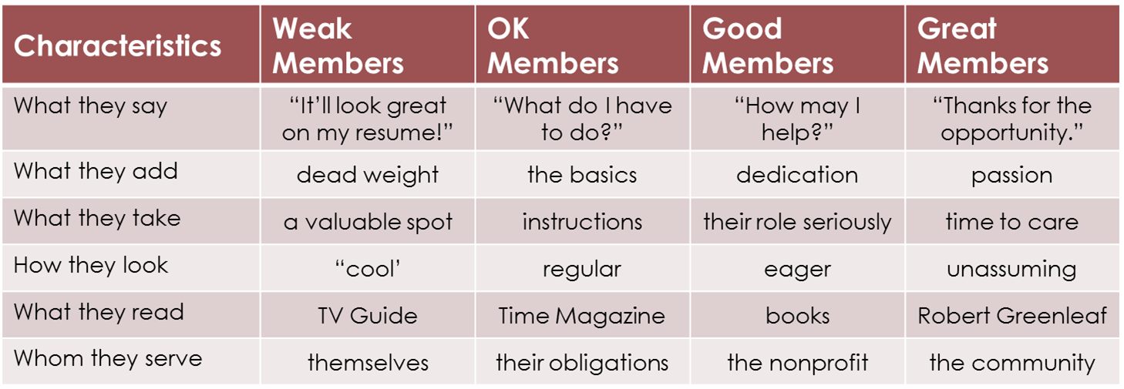
Characteristics of a Great Board
Great board members emerge by having a broader perspective than self or even the nonprofit: they develop a vision that links the nonprofit to the broader nonprofit sector and act to serve, strengthen, and transform the entire community. Indeed, great board members are “community trustees.”
“Voluntary action on behalf of the common good is the inherited legacy of every American…” Katherine Tyler Scott
Notes:
To achieve those purposes, we want to exhbit the characteristics of a great board. Boards do not typically start off great but they travel along a continuum, picking up and mastering certain skills. After mastering these phases, great board members emerge by having a broader perspective than self or even the organization: they develop a vision that links the organization to the boarder network, to serve, strengthen, and transform the enteire community.
Passion, time, engaged, dedicated to service to the membership,

Slide 50
Effective Governance
“The most effective governing boards of nonprofit organizations not only carry out their fundamental responsibility to act in the public interest and to fulfill their legal duties, but also provide leadership.”
Notes:
Just a quote to leave you with....

Slide 51
Leadership & Engagement
CAA Board Governance

Slide 52
Community Needs Assessment
Participation in all phases of the needs assessment process
Creation of a needs assessment committee
Engagement of key stakeholders
Survey input
Review and approval of needs assessment results

Slide 53
Strategic Planning
Participation in all phases of the strategic planning process
Creation of a strategic planning committee
Provision of advice on strategic direction
Review of mission and vision
Approval of strategic plan
Oversight of strategic plan implementation
Notes:
2. Starting with a “Mission Moment” when someone shares a story about an activity or incident that successfully demonstrates the ways in which agency work helps meet the mission.

Slide 54
Monitoring
Attentiveness with agency monitoring
Staying informed about monitoring visits
Anticipating findings
Leading by example
Reviewing monitoring reports
Ensuring prompt corrective action when needed
Commonly Faced CSBG Monitoring Findings and Potential Approaches for Addressing Them – CAPLAW RESOURCE
Notes:
Board vacancies and composition. Board neglecting responsibilities.

Slide 55
Fiscal
Oversight for sound fiscal management
Knowledge, understanding, and approval of financial statements
Audit process involvement
Policies and procedures in place and followed
Internal financial controls
Timeliness
Finance Committee with financial expertise

Slide 56
Big Picture: Board Cliff Notes
CAA Board Governance

Slide 57
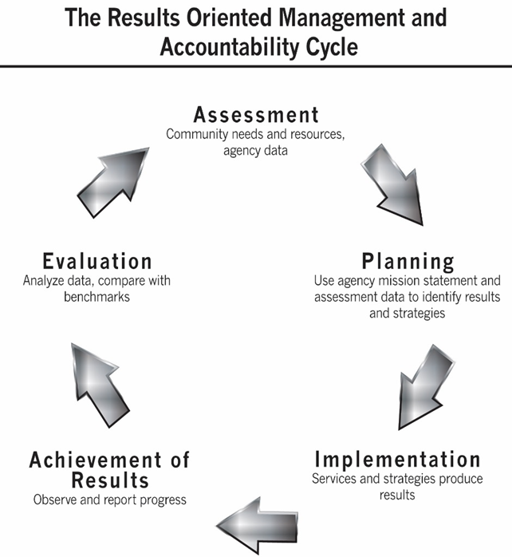
ROMA Next Generation
Three National Goals
Individuals and families with low incomes are stable and achieve economic security
Communities where people with low incomes live are healthy and offer economic opportunity
People with low incomes are engaged and active in building opportunities in communities
Notes:
See the training Module on ROMA for more information on what Boards should know about ROMA

Slide 58
National Theory of Change

Slide 59
CSBG Organizational Standards
Organized into three thematic groups
Maximum Feasible Participation
Consumer input and involvement
Community engagement
Vision and Direction
Organizational leadership
Board governance
Operations and Accountability
Human resource management
Financial operations and oversight
Community assessment
Strategic planning
Data and analysis
Notes:
Shift the frame from compliance to capacity building
Standards provide a framework for self-analysis, application of ROMA process

Slide 60
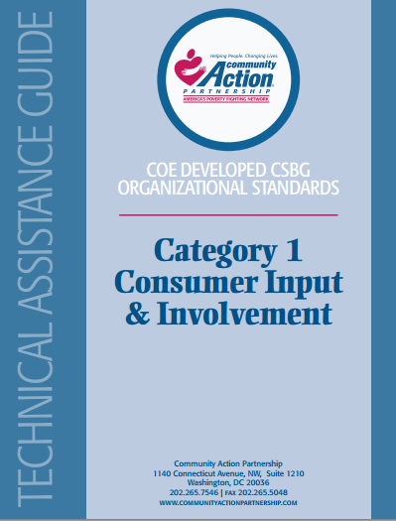
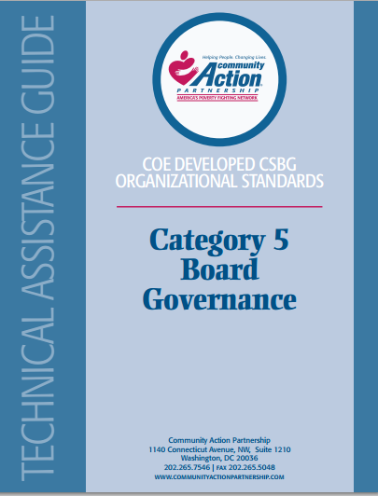
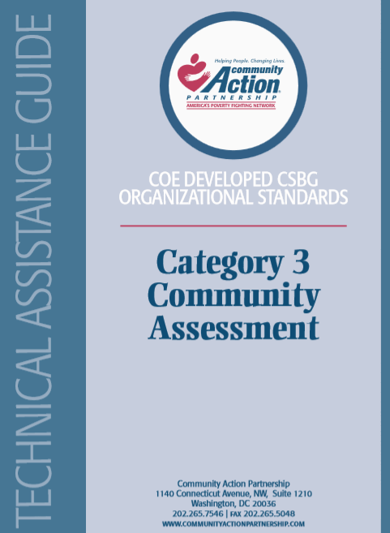
T/A Guides Toolkits and Webinars for Each of the Nine Categories
Additional Guidance
Definition
Compliance
Document
Beyond Compliance
Resources
Assessment Scales

Slide 61
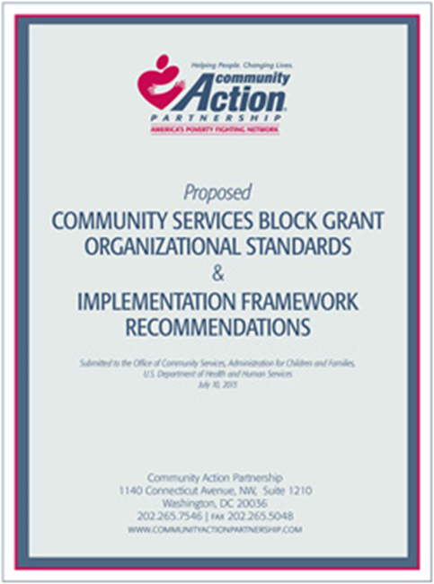
CSBG Organizational Standards
Category 5: Board Governance
Tripartite Board
Democratic Selection
Bylaws reviewed by an attorney
Bylaws for each board member
Quorum & Filling Vacancies
Conflict of Interest Policy
Board Orientation – new members
Board Training – ongoing
Program status reports
With board components in many other categories, as well.
Notes:
See Organizational Standards for Boards training module for more information on what the board should know about these standards.

Slide 62
Boards of Directors/Advisory Boards
Handouts
Videos

Slide 63
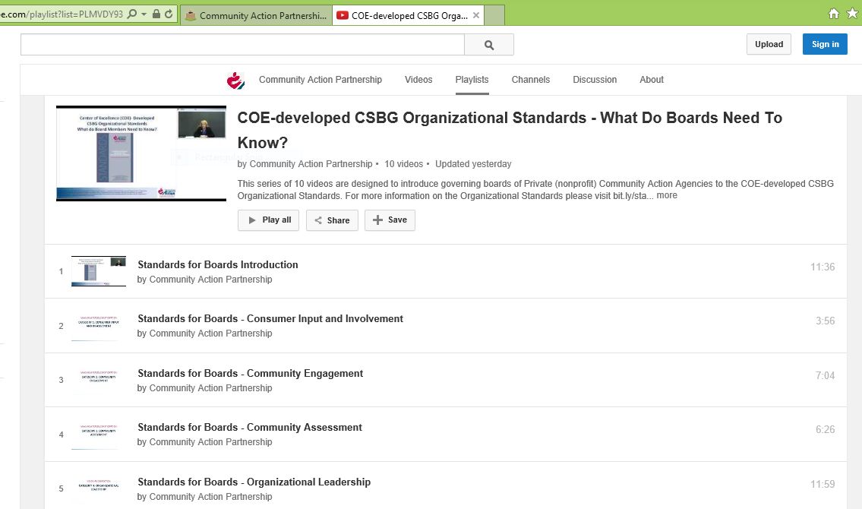
Community Action Partnership YouTube Channel-Board Videos

Slide 64
What Are the Community Action Standards of Excellence?
The Community Action Standards of Excellence represent 35 of the very best practices of the very best agencies.
They represent real-world administrative and operational benchmarks that every agency can strive for.

Slide 65
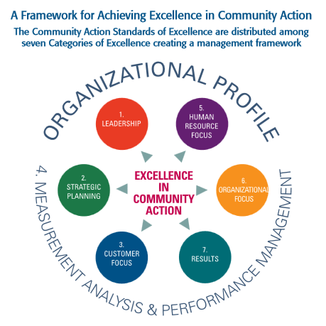

Slide 66
Online Resources for CA Boards
Virtual CAP: http://www.virtualcap.org/Index.cfm
CAPLAW: http://caplaw.org/
National Community Action Foundation: http://ncaf.org/
Community Action Partnership: http://www.communityactionpartnership.com/
NASCSP: www.nascsp.org
Board Source: www.boardsource.org
Blue Avacado: www.blueavacado.org

Slide 67
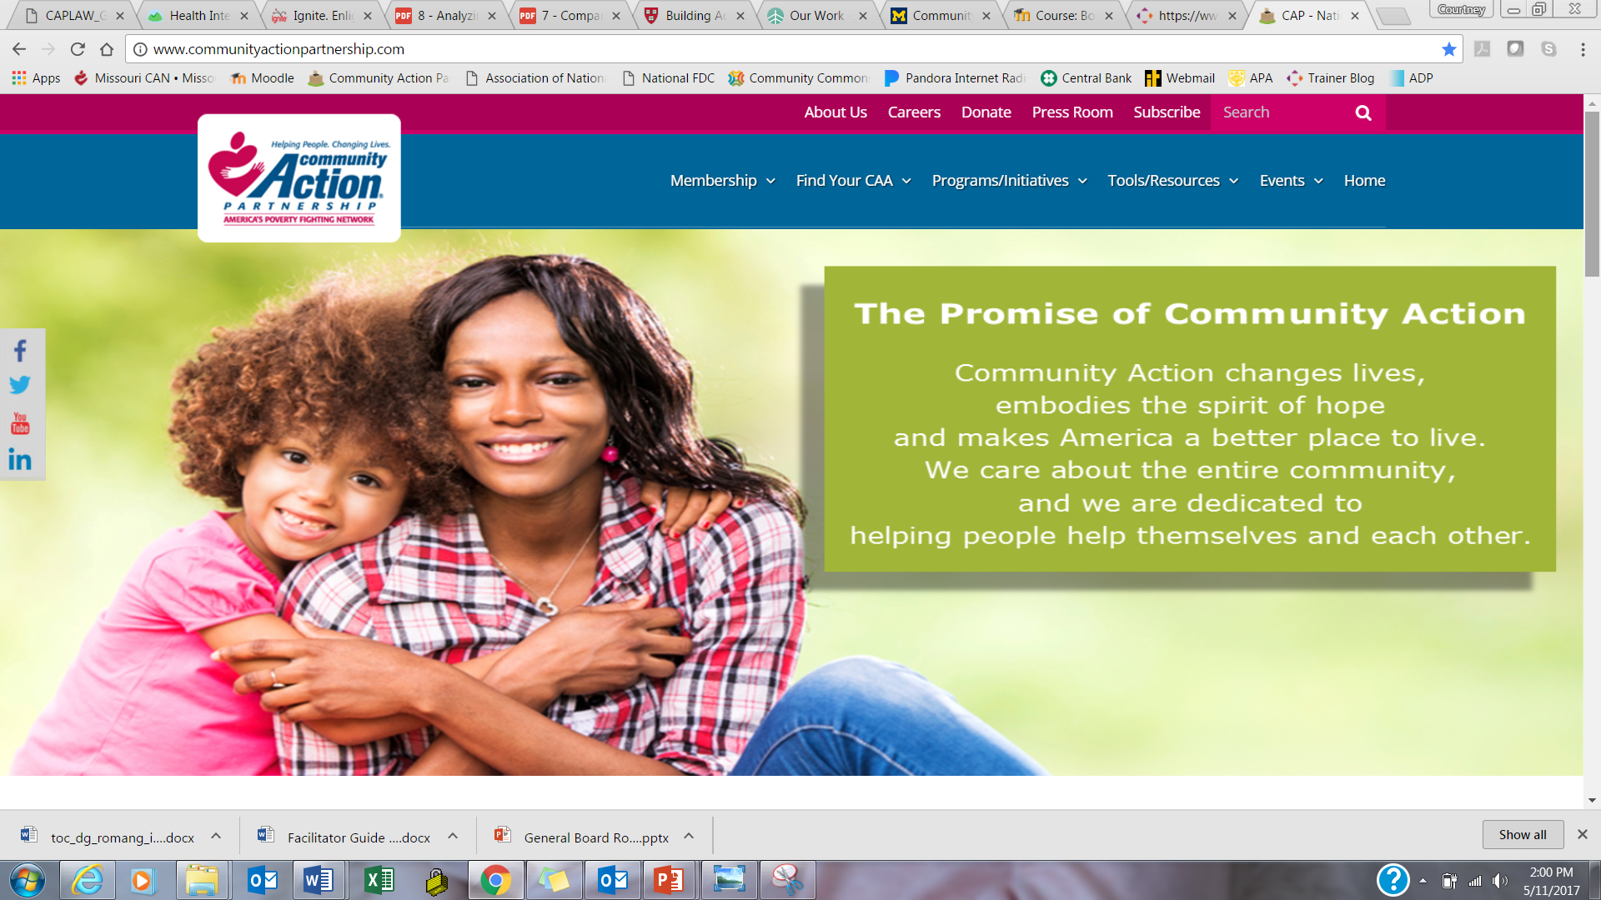
www.communityactionpartnership.com

Slide 68
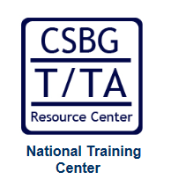
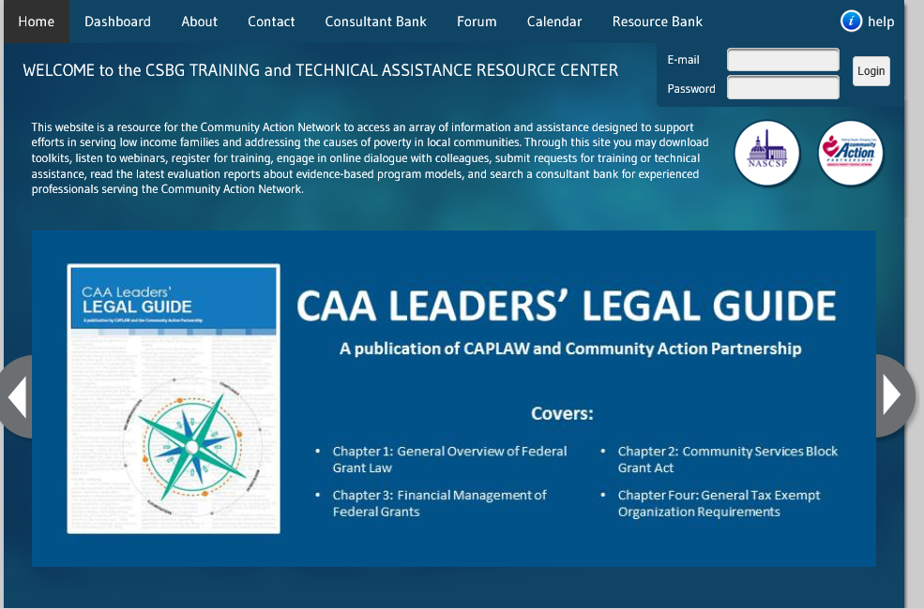
CSBG T/TA Resource Center
www.csbgtta.org
Many more toolkits, webinars, and print resources
Consultant Bank
Training Calendar
Discussion Forum
Shared Calendar

Slide 69
Additional Resources
Sample Job Description from Bridgespan:
http://www.bridgespan.org/getattachment/cf0eabfc-c5d4-4870-816b-e004f27eef7f/Board-Member-Job-Description-Sample.aspx
Sample Board Mentor Job Description:
http://agb.org/sites/agb.org/files/u16/Mentor%20Program%20Scripps.pdf
Board Best Practices Checklist:
http://www.caplaw.org/resources/SelfAssessmentDocuments/CAPLAW_BoardResponsibilitiesChecklist_2010.pdf
Board Crisis Management Checklist:
http://www.virtualcap.com/downloads/US/US_ROMA_CAA_Management_Crisis_Checklist.pdf

Slide 70
Contact Information
Courtney Kohler, CCAP, NCRT Senior Associate Community Action Partnership
ckohler@communityactionpartnership.com
Jarle Crocker, PhD, NCRT
Director of Training and Technical Assistance
Community Action Partnership
Jcrocker@communityactionpartnership.com
Lisa An
Program Associate
Community Action Partnership
Lan@communityactionpartnership.com

